Slide 1
Advocacy for All:
An Introduction to Serving Incarcerated Survivors
California Advancing PREA
Workshop 1 of 3

Slide 2
CA Advancing PREA Overview
CALCASA and JDI will offer support and guidance to all rape crisis centers on how to build strong relationships with California Department of Corrections and Rehabilitation staff and how to create sustainable agreements and protocols for the provision of victim services to survivors.

Slide 3
Project Goals
Help advocates and prison staff understand each other’s roles and culture
Build capacity of rape crisis centers and prisons to provide trauma-informed services
Develop a program of services for survivors that is sustainable

Slide 4
Learning Outcomes
Develop an understanding of the basics of detention in the United States and sexual abuse behind bars
Identify and address concerns and challenges in supporting incarcerated survivors
Demonstrate how serving incarcerated survivors fits into the overall movement to end sexual violence
Determine readiness to provide services to incarcerated survivors

Slide 5
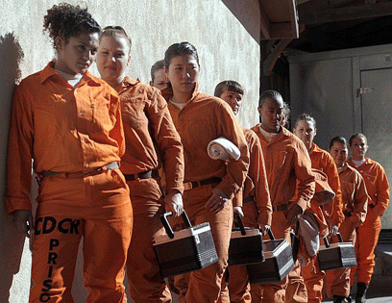
Workshop Agenda
Detention in America
Sexual abuse behind bars
Making a movement for all survivors
Assessing our readiness
Resources
Photo: Maya Sugarman/LA Daily News

Slide 6
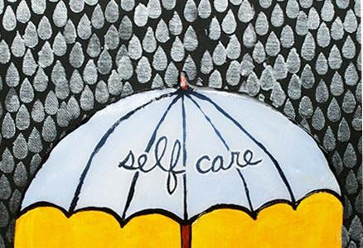
© Julie Fei-Fan Balzer

Slide 9
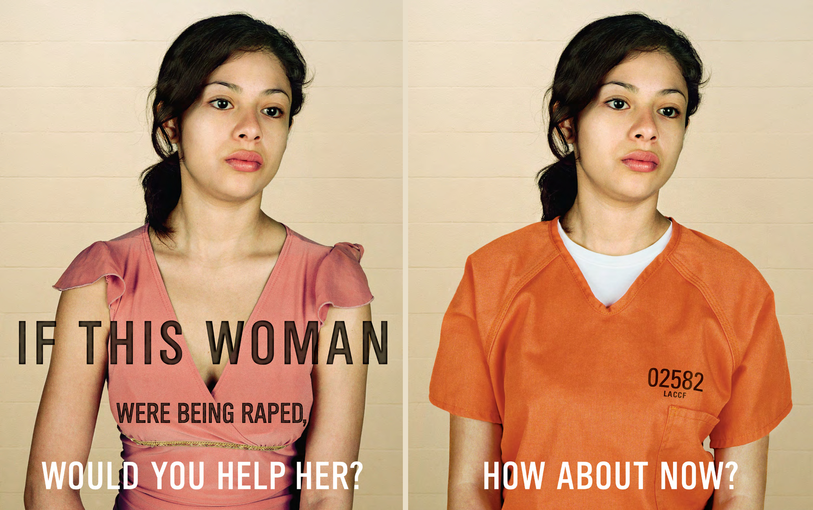

Slide 10
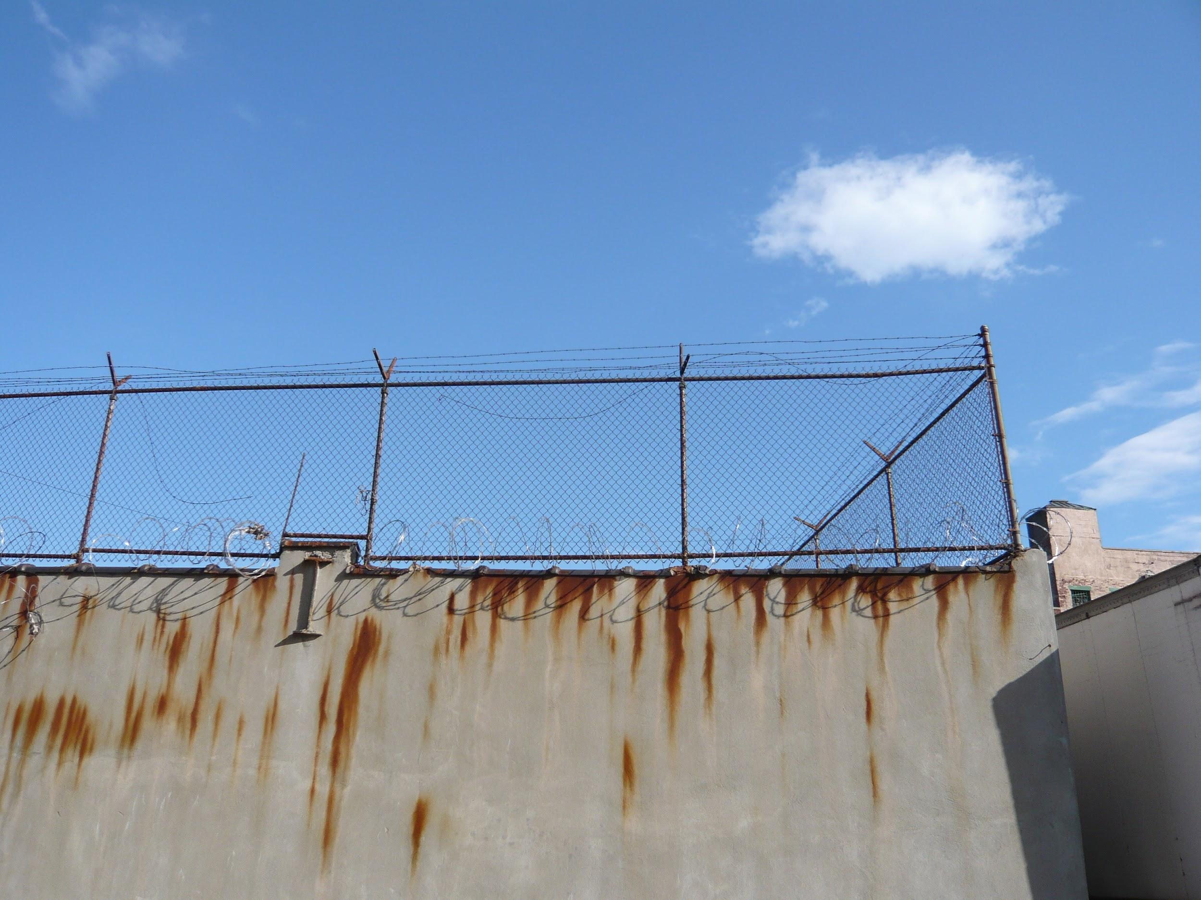
Detention in the United States
Photo credit: Jason Eppink

Slide 11
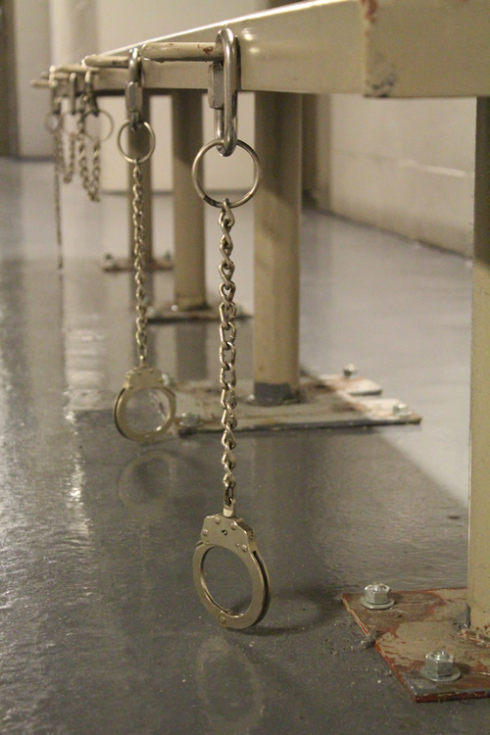
What is Detention?
Prisons
Jails
Lockups
Fire camps
Community confinement facilities
Juvenile facilities
Immigration facilities
Photo: Just Detention International

Slide 12
Detention Operations
City
County
State
Federal
Bureau of Prisons
Department of Homeland Security
Private corporations
GEO Group
CoreCivic
Galls, LLC

Slide 13
Image by Statista. Source: Bureau of Justice Statistics, Department of Justice

Slide 14
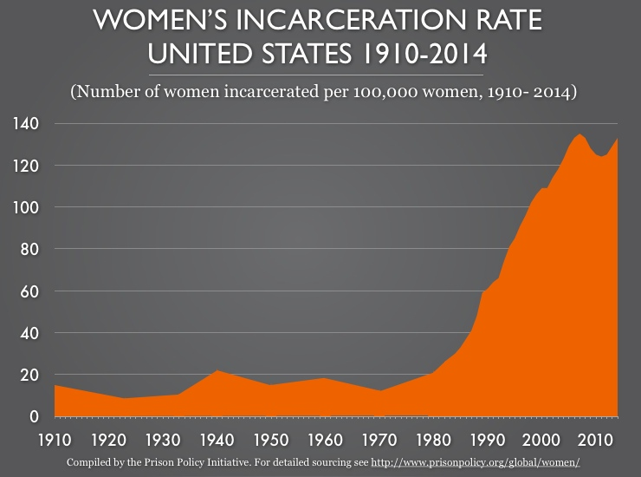

Slide 15
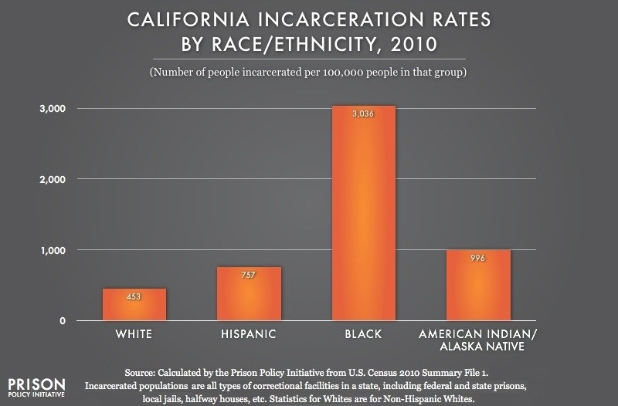

Slide 16
rightsforgirls.org

Slide 17
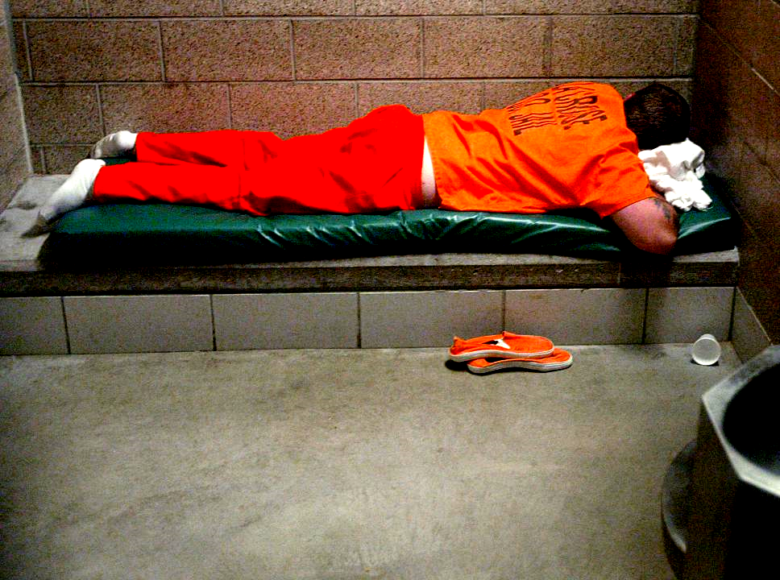
People with serious mental health problems are over three times more likely to wind up in a prison or jail than a hospital.
Source: E. Fuller Torey, M.D, et al, More Mentally Ill Persons Are in Jails and Prisons Than Hospitals: A Survey of the States, 2010. Photo: Peter Thomson/La Crosse Tribune

Slide 18
Structural Violence:
when the rules, norms, or culture of an institution cause harm to people, including violations of human rights.

Slide 19
Structural Violence | Community Institutions | Detention Facilities
Code of silence
Normalized violence
Prejudice
Retaliation
Isolation
Violence is ignored
Violence is ignored
Violence is dismissed
Violence is dismissed
Violence is seen as Violence is seen as deserved deserved
Survivors are Survivors are
punished punished
Survivors can’t Survivors can’t
get help get help

Slide 20
Sexual Abuse Behind Bars
iStock photo

Slide 21
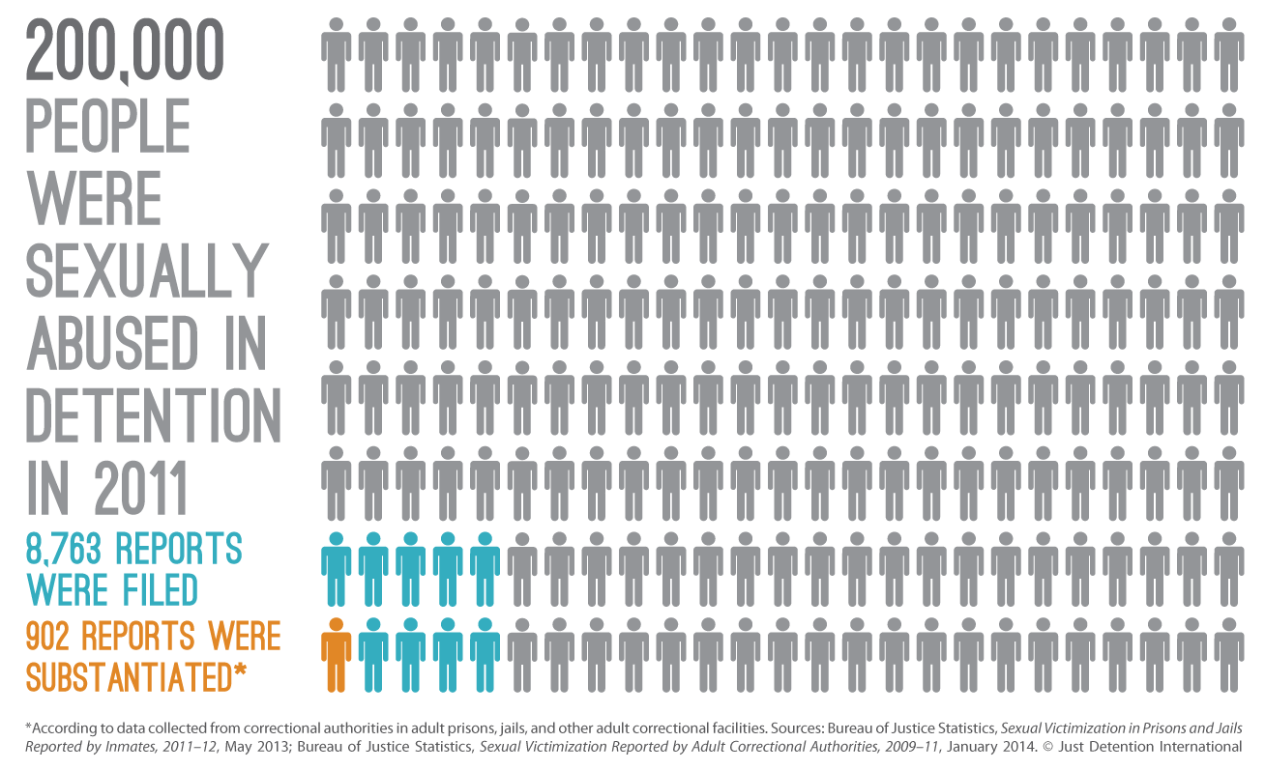

Slide 22
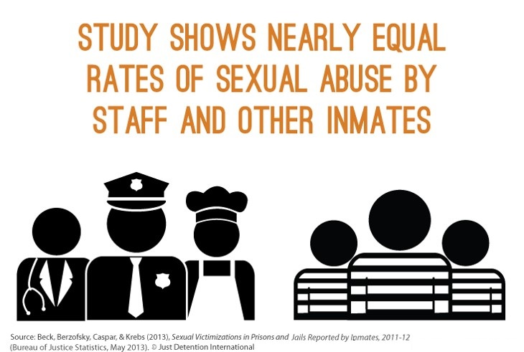

Slide 23
Who is more likely to be targeted for sexual abuse behind bars?

Slide 24
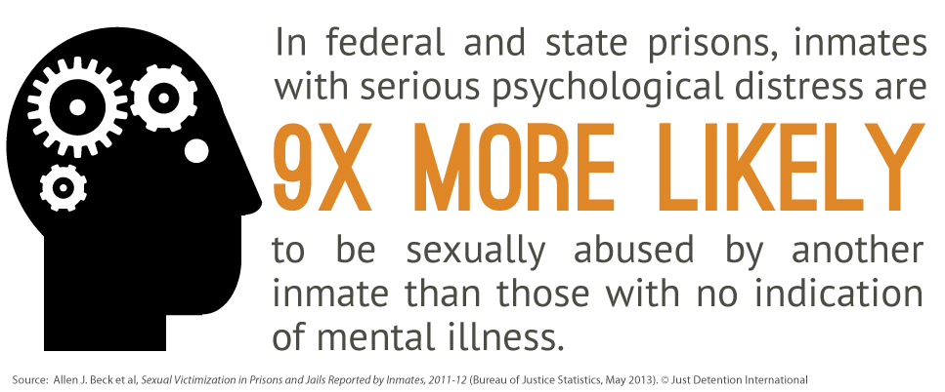

Slide 25
In His Own Words
“There’s no therapy for rape victims in prison. The prison system is incompetent to handle the mentally ill, and in fact causes the mental illness that it should be treating.”
— Scott, a survivor of sexual abuse in an Illinois prison

Slide 26
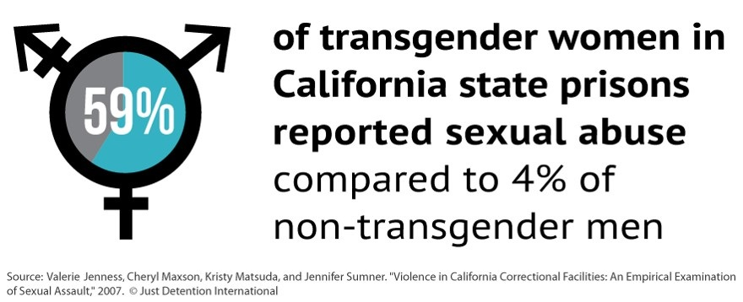

Slide 27
“The options for me are to ‘choose up’ with a ‘husband’ that’s both strong enough and respected enough to protect me and with enough income to take care of me as his ‘prison wife.’ Or I can be conscripted into a gang as a ‘prison gang bitch,’ and forced to have multiple sex partners who may or may not take care of me. So I try to choose the lesser of two evils.”
— Desi, a transgender woman serving time at a men’s prison who was in several sexually abusive protective pairings

Slide 29
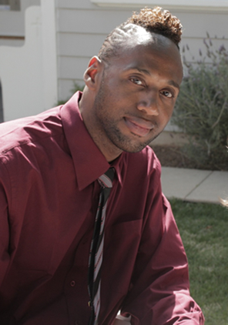
In His Own Words
“I didn’t know my sexual orientation, but I knew that I was different. Soon after entering juvenile hall, one boy forced me to have oral sex with him in the shower area. He claimed that he would protect me from others, but he didn’t.”
— Troy Isaac JDI Survivor Council member
Just Detention International

Slide 30
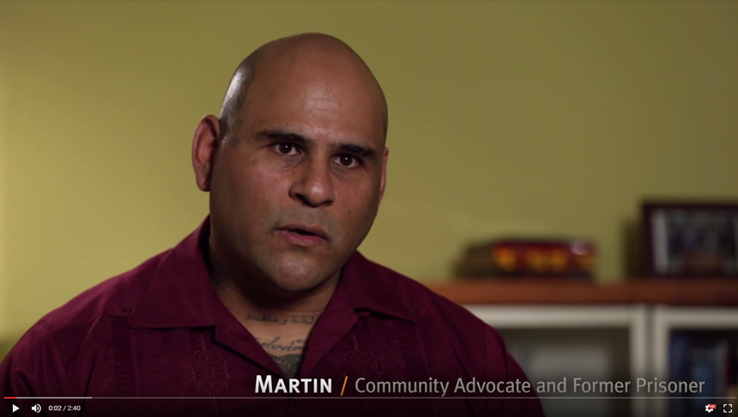

Slide 31
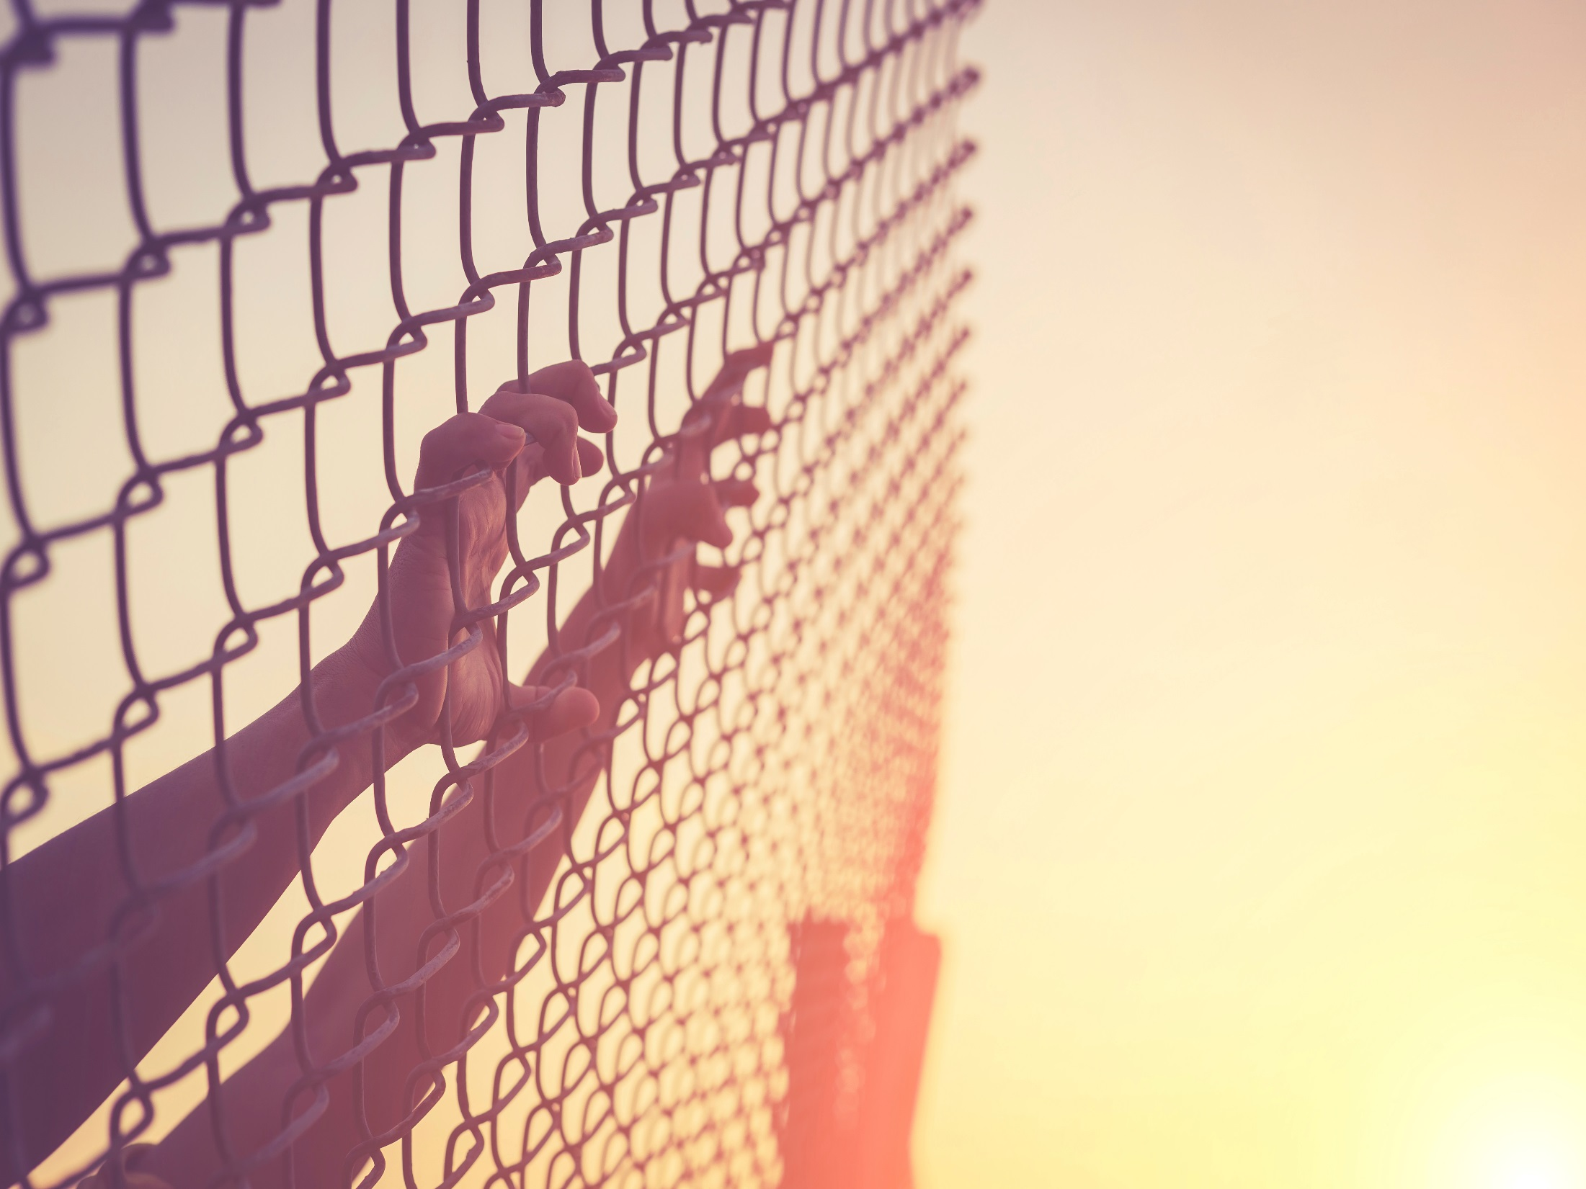
A Movement
For All Survivors
iStock photo

Slide 32
Bias Against Incarcerated Survivors
Fear of incarcerated people and settings
Negative media representation
Rigidity around definition of a victim or survivor
Sexual violence against incarcerated people seen as “not our problem”
Just Detention International

Slide 33
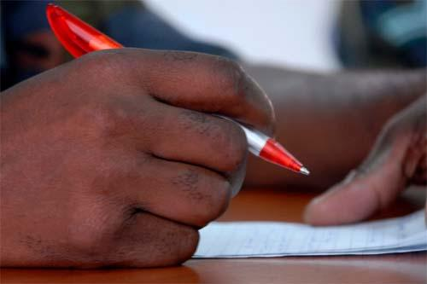
Tips for Addressing Concerns
Identify and ask for what you need
Know and use your resources
Address challenges directly
Visit detention facilities
Do cross-training
Develop strong policies and protocols
Rick Scavetta, U.S. Army Africa Public Affairs

Slide 34
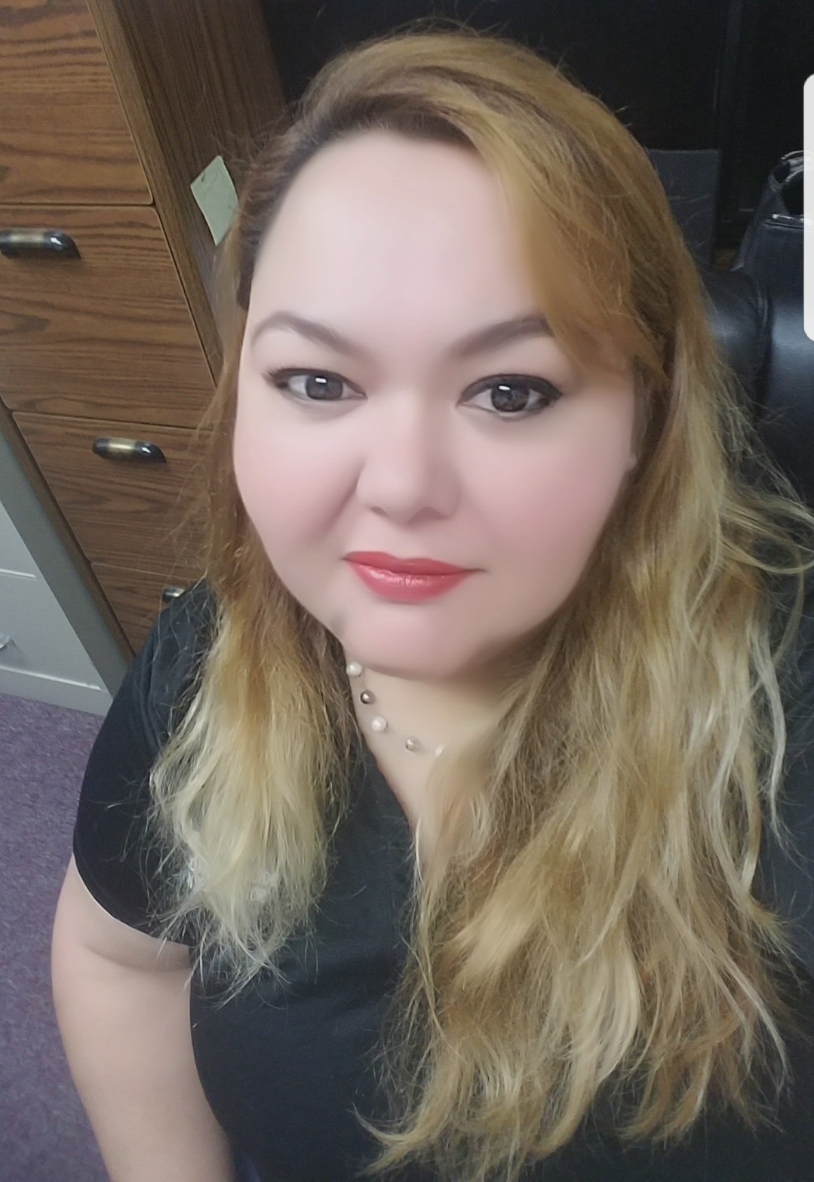
Voices of Advocates
“Be open-minded
and open-hearted.”
— Karla Victim Advocate at Sure Helpline
Karla Soto

Slide 35
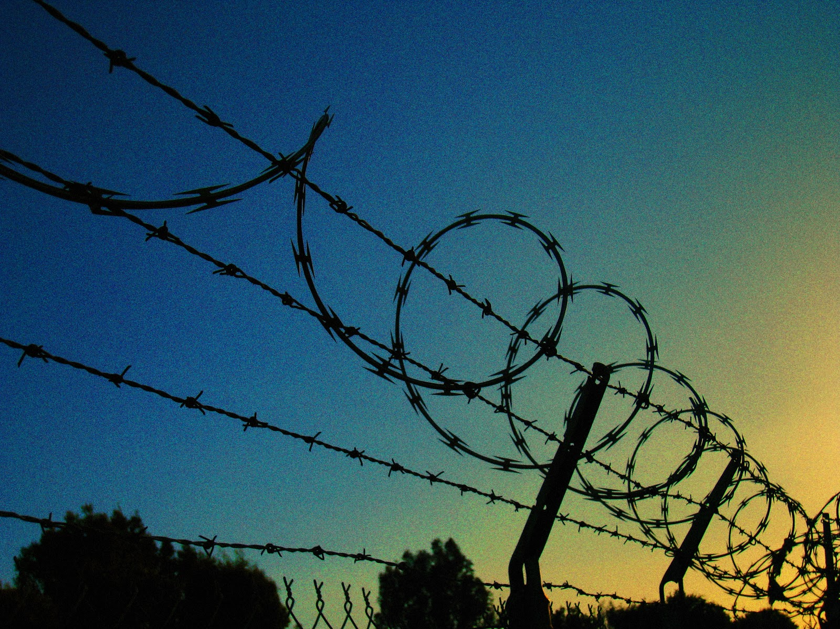
Assessing Your Readiness
Bill Selak

Slide 36
“So long as some 200,000
people are sexually violated in detention centers annually, rape will never really retreat into the realm of the unthinkable, no matter how many perpetrators we turn into victims.”
Elizabeth Stoker Bruenig, “Why Americans Don’t Care About Prison Rape,” The Nation, March 2015

Slide 37
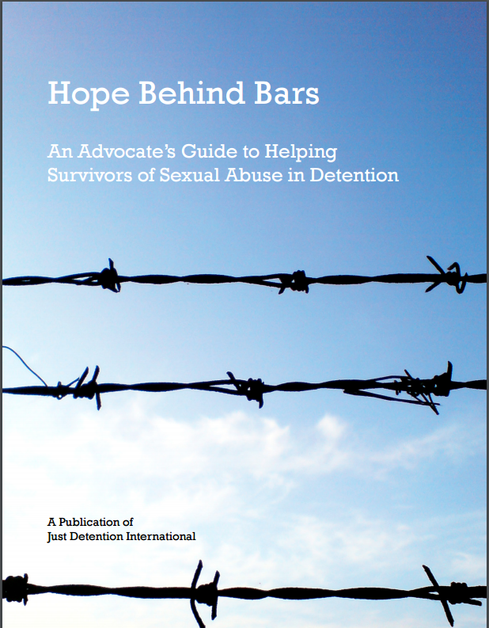
Online Resources
Just Detention International justdetention.org
Hope Behind Bars: An
Advocate’s Guide
Hope for Healing: Information for Survivors
Archived webinars
Other publications

Slide 38
CA Advancing PREA Contact Information
We are here to support you:
prea@calcasa.org
or
advocate@justdetention.org

Slide 39
iStock

Slide 40
Acknowledgments
This project is supported by Grant No. AP14-01-8671, awarded by CalOES. The opinions, findings, conclusions, and recommendations expressed in this training are those of the authors and do not necessarily reflect the views of the Governor’s Office of Emergency Services.

