Slide 1
Doing the Work: Providing Services to Incarcerated Survivors
Advancing PREA
Workshop 3 of 3

Slide 2
CA Advancing PREA Overview
CALCASA and JDI will offer support and
guidance to all rape crisis centers on how to
build strong relationships with California
Department of Corrections staff and how to
create sustainable agreements and protocols
for the provision of victim services to
survivors.

Slide 3
Project Goals
Help advocates and prison staff understand each other’s roles and culture
Build capacity of rape crisis center and prisons to provide trauma-informed services
Develop a program of services for survivors that is sustainable

Slide 4
Learning Objectives
Compare dynamics of sexual abuse behind bars to dynamics in the community
Explain ways to frame services to corrections in order to facilitate service provision
Describe services to survivors and explain how they can access them
Identify strategies and tools for providing services to incarcerated survivors
Practice skills via scenarios and troubleshooting common challenges

Slide 5
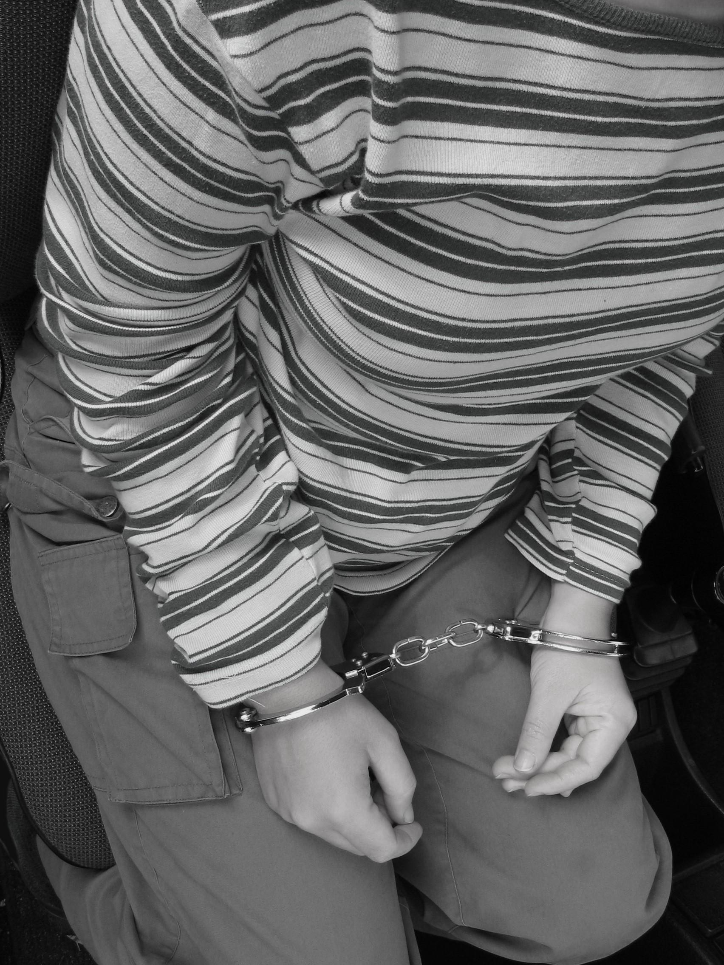
Workshop Agenda
Dynamics of sexual abuse behind bars
Role of the advocate
Providing services
Scenarios & common challenges
Resources
iStock

Slide 6
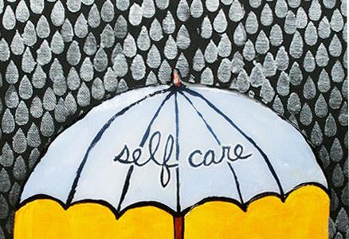
© Julie Fei-Fan Balzer

Slide 7
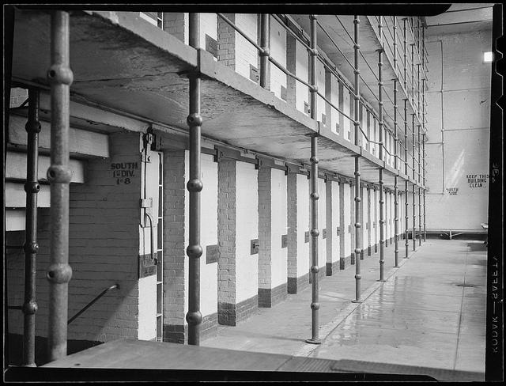
Dynamics of Sexual Abuse
in Detention
Leslie Jones

Slide 8
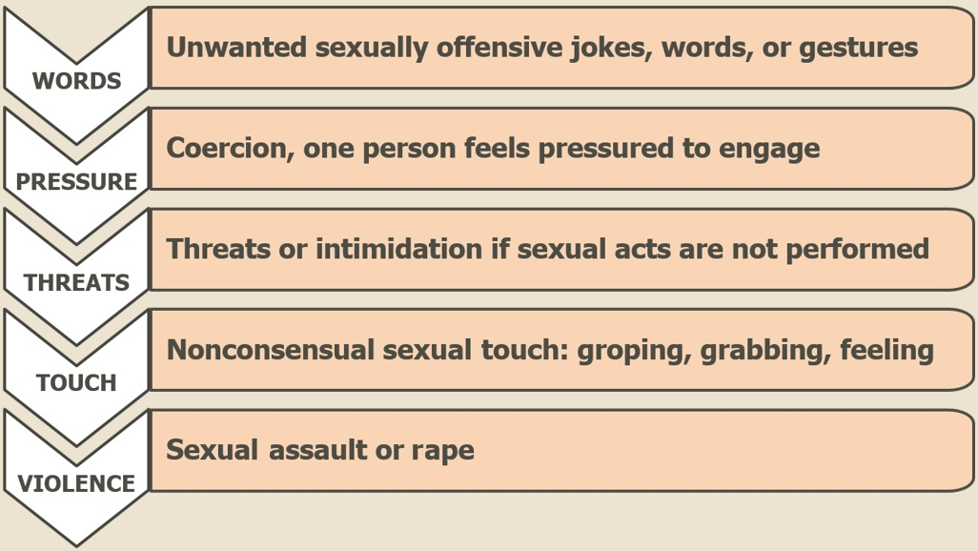
Spectrum of Sexual Abuse

Slide 9
Complex Trauma
Incarcerated survivors are likely to have histories of:
Child abuse
Relationship violence
Sexual exploitation
Gang violence
Health disparities
Galls, LLC

Slide 10
Power and Control
Inherent to corrections facilities
Staff, by definition and role, have it
Creates an ‘us vs them’ dynamic
Exists on many layers, including among inmates
California Department of Corrections and Rehabilitation

Slide 11
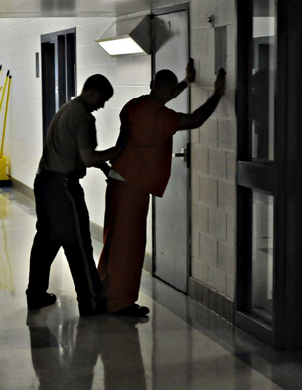
Abuse by Staff
Abuse of authority
Sexual harassment
Voyeurism
Abusive searches
Sexual violence and rape
Tom Hindman

Slide 12
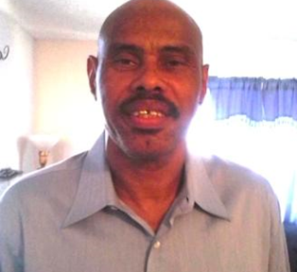
In His Own Words
“Often, people think that you deserve whatever happens to you in prison because you have committed a crime. But no one should be sexually assaulted by an officer. Inmates have no power to protect themselves, so we rely on the officers to make it a safe environment.”
— Ivory, survivor of sexual abuse by a female officer

Slide 13
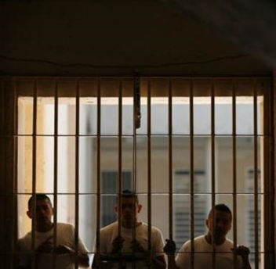
Abuse by Other Inmates
Sexual harassment
Protective pairing and relationship abuse
Sexual exploitation
Gang abuse
Sexual abuse and rape
Carlos Jason/Reuters

Slide 14
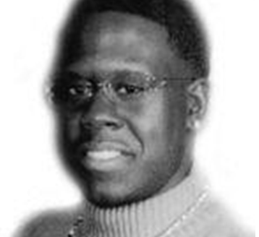
In His Own Words
“This was, in a word, enslavement. My body no longer belonged to me, but to someone else — to my ‘husband’, a rapist who totally controlled my life with the constant threat of violence.”
— Rodney, survivor of sexual abuse by other inmates

Slide 15
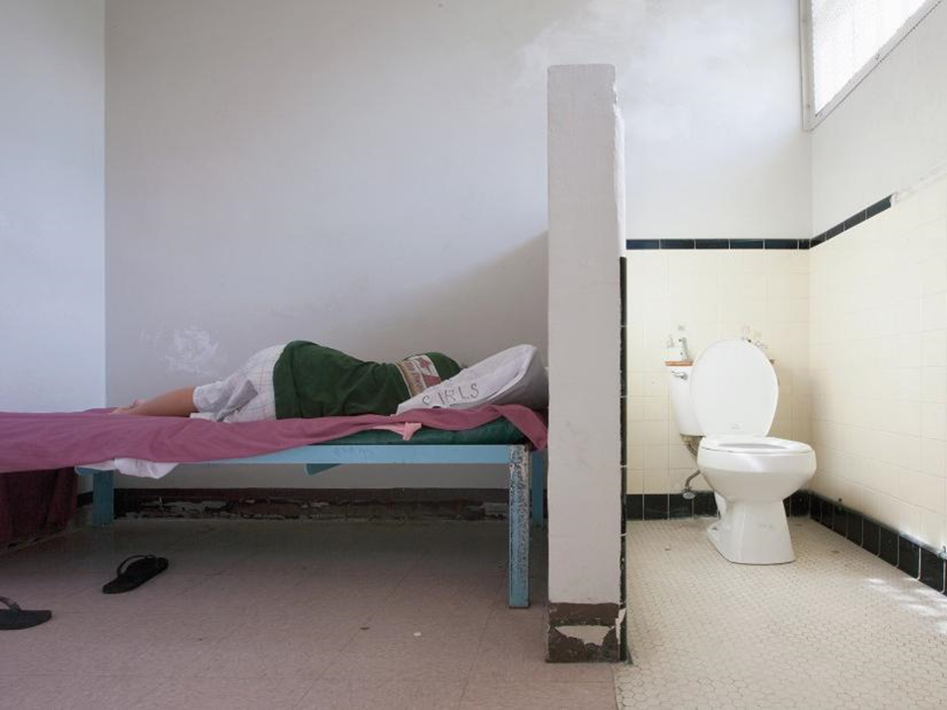
What Advocates
Can Do
Richard Ross

Slide 16
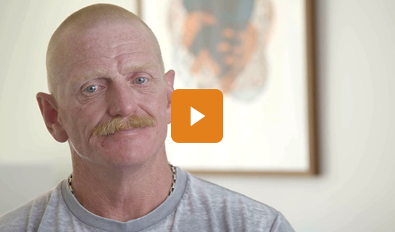

Slide 17
What did Joe say were the most powerful services the advocate provided?

Slide 18
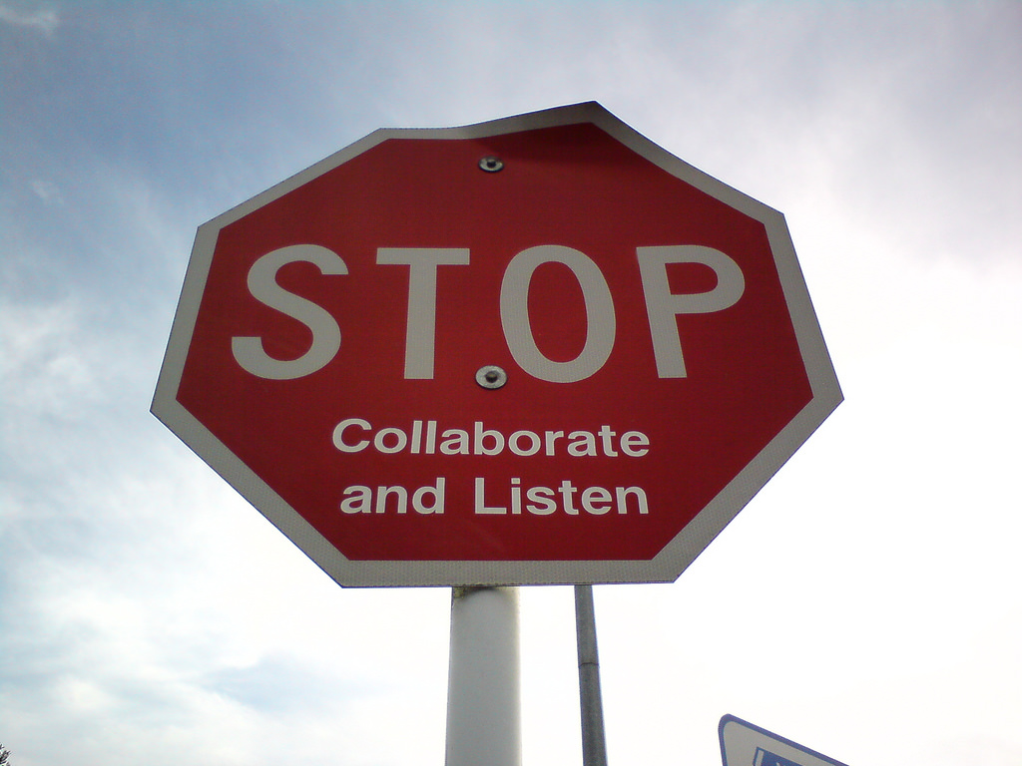
The Empowerment Model
No assumptions
Trust is earned
Validation is key
Options, not advice
Survivor is the expert
Wonderferrit/flickr

Slide 19
The Empowerment Model
Setting Boundaries
Be proactive
Be realistic
Stay within your scope of work
Be consistent and reliable
Be prepared
Nina Matthews Photography

Slide 20
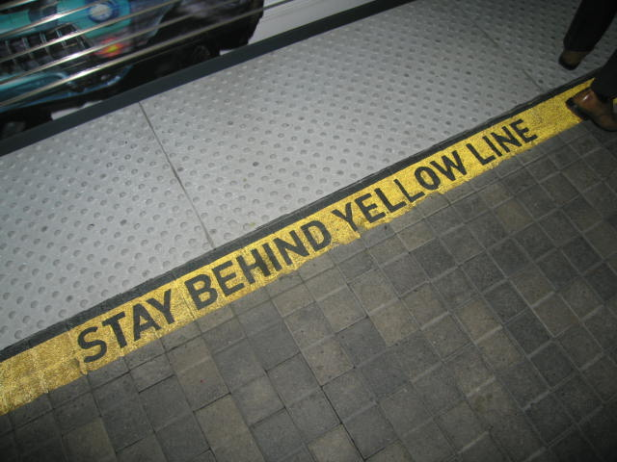
The Empowerment Model
Safety Planning
Let survivor guide the process
Ensure accessibility
Don’t make guarantees
Just Detention International

Slide 21
Survivor
Coping Skills
Detention Resources
Community Resources
Support People

Slide 22
The Empowerment Model
Youth and Confidentiality
Be clear about rights and limits of confidentiality
Include the youth in reporting, when possible
Understand the route for reporting within the system
Getty Images

Slide 23
Voices of Advocates
“I’m excited about working closely with the youth detention facility. Working with some of the most vulnerable communities who are disproportionately imprisoned is important to me. I feel privileged to have received quality training on PREA to empower me to better support youth with emotional support, resources, and advocacy.”
— Sandy Gomez, PhD, Rape Crisis Center Supervisor, The Coalition for Family Harmony

Slide 24
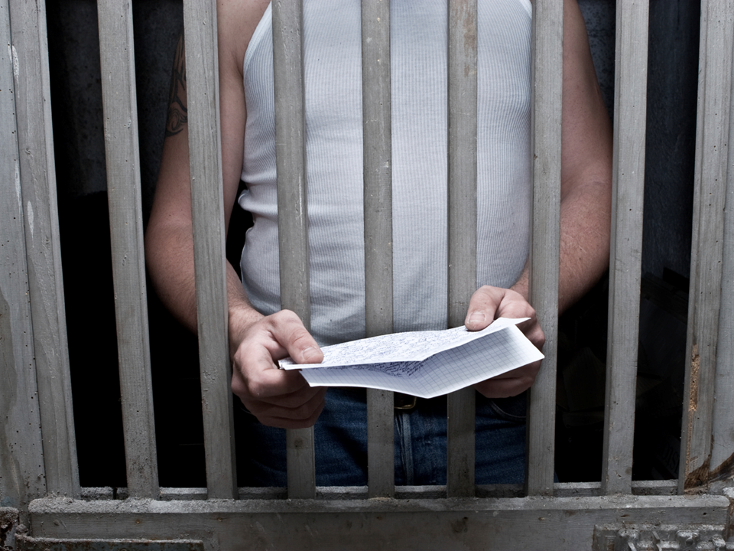
Written Correspondence
A Zemdega

Slide 25
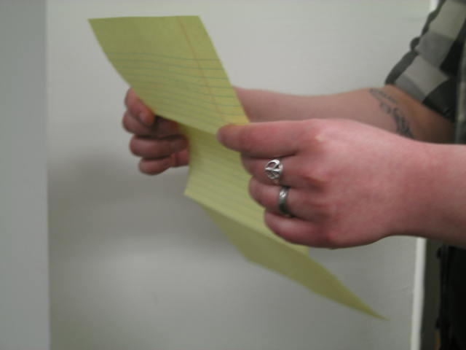
Things to Consider
Confidentiality and mandated reporting
Accessibility and language
Consistency and timeliness
Appropriateness of referrals
Boundaries
Just Detention International

Slide 26
Scenario:
Written Correspondence
Justin Sullivan/Getty Images

Slide 28
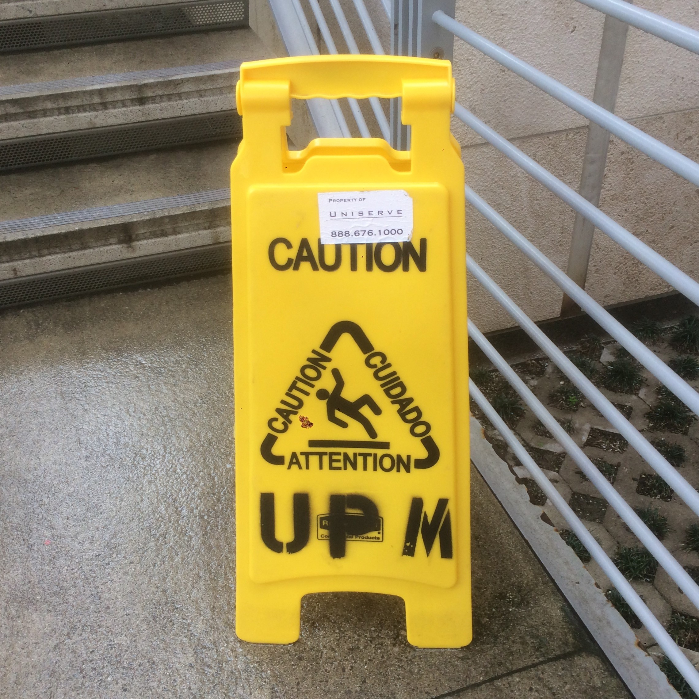
Concerns
Ongoing abuse
Multiple victims
Potential institutional corruption
Survivor feels hopeless and alone
Just Detention International

Slide 29
How to Respond
Validate feelings, normalize trauma responses
Focus on survivor’s strengths and community-building
Explore resources
Explore options
Max Oppenheim/Getty Images

Slide 31
Concerns
Inappropriate tone
Off-topic and unusual requests
Boundary-crossing
Just Detention International

Slide 32
How to Respond
Establish boundaries
Clarify role and services available
Offer appropriate resources
Max Oppenheim/Getty Images

Slide 33
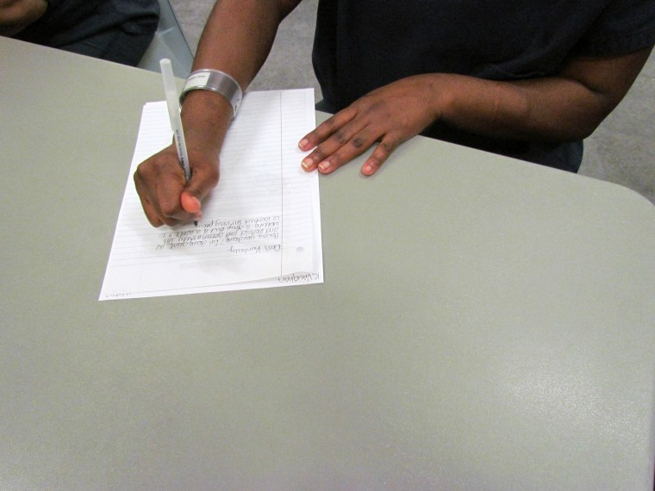
“If you only knew the strength I get every time I get a letter from you all. I used to think I was alone. Thanks so much for the support.”
— Ricardo, a prisoner rape survivor

Slide 35
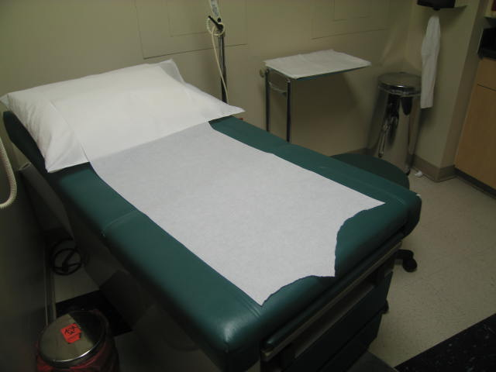
Hospital Accompaniment
Hospital Accompaniment
Just Detention International

Slide 36
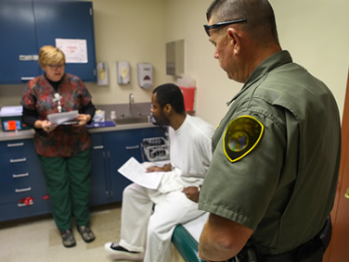
Things to Consider
Location of exam
Process of notification
Presence of corrections officers
Confidentiality
Corrections’ use of restraints
Accessibility of follow up support
California Department of Corrections and Rehabilitation

Slide 37
Hospital Accompaniment
Scenario:
Hospital Accompaniment
Just Detention International

Slide 38
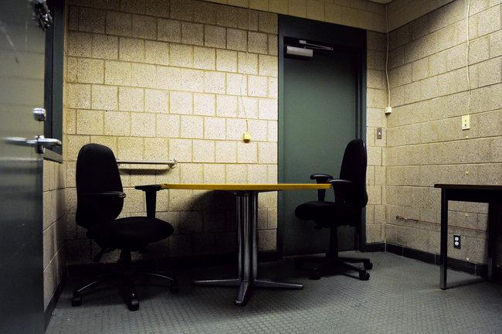
Scenario Exercise
You receive a call to accompany an incarcerated survivor for a forensic exam. When you arrive, the survivor is shackled and there are two corrections officers with him. You introduce yourself and ask the officers to step out of the room so you can speak confidentially with the survivor. One of the officers says:
“We can’t allow that. We need to be in here at all times. It’s for your safety.”
What do you do?
Robert Stolarik/The New York Times

Slide 39
Challenges
Advocacy and survivor rights | Relationship building and safety concerns
Survivor has the right to confidentiality | Building relationships will ensure future survivors receive support
Confidentiality allows for you to best advocate for survivors | Officers know more about this survivor, have authority
You can earn trust and create safety through confidentiality | Possible safety concerns

Slide 40
How to Respond
Brainstorm other options
Educate and advocate respectfully
Use the SAFE nurse as an ally
Check in with the survivor
California Department of Corrections and Rehabilitation

Slide 41
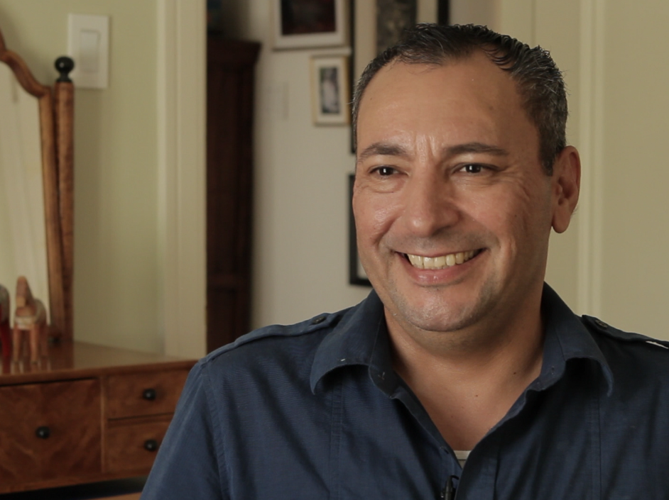
“If I had an advocate, it would have saved me so much grief. It would have helped me through that traumatic event immensely. Going through it alone, I didn’t know who I could trust and who I could talk to about it — which appeared to be nobody.”
— Frank Mendoza, prisoner rape survivor and member of JDI’s Survivor Council

Slide 42
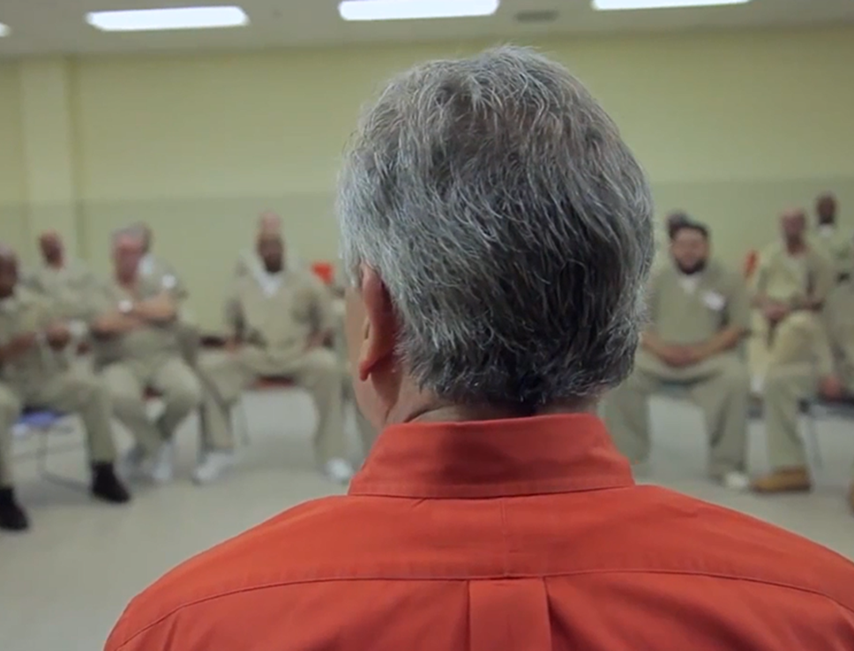
In-Person Counseling
Adam Loften/The Path of Freedom

Slide 43
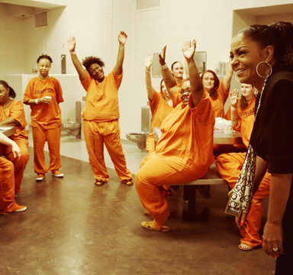
Support Behind Bars
Incarcerated survivors have little access to support services
Facility mental health may not treat trauma
Advocates have needed skills
Pat Sullivan/AP Photo

Slide 44
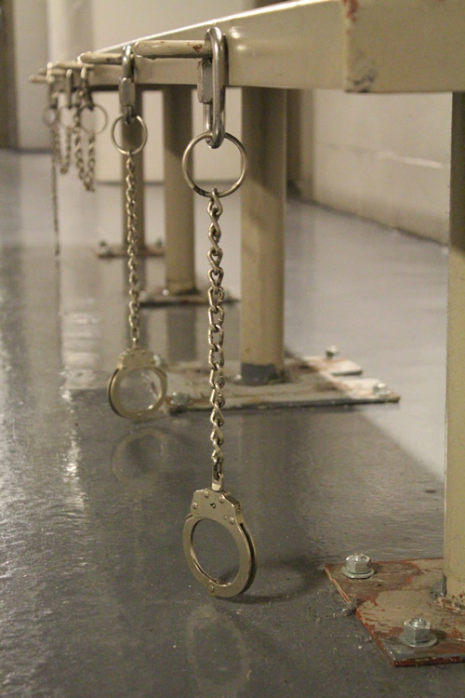
Things to Consider
Take a facility tour
Ask about counseling spaces available
Be familiar with visitor policy
Develop intake and consent forms
Establish boundaries
Just Detention International

Slide 45
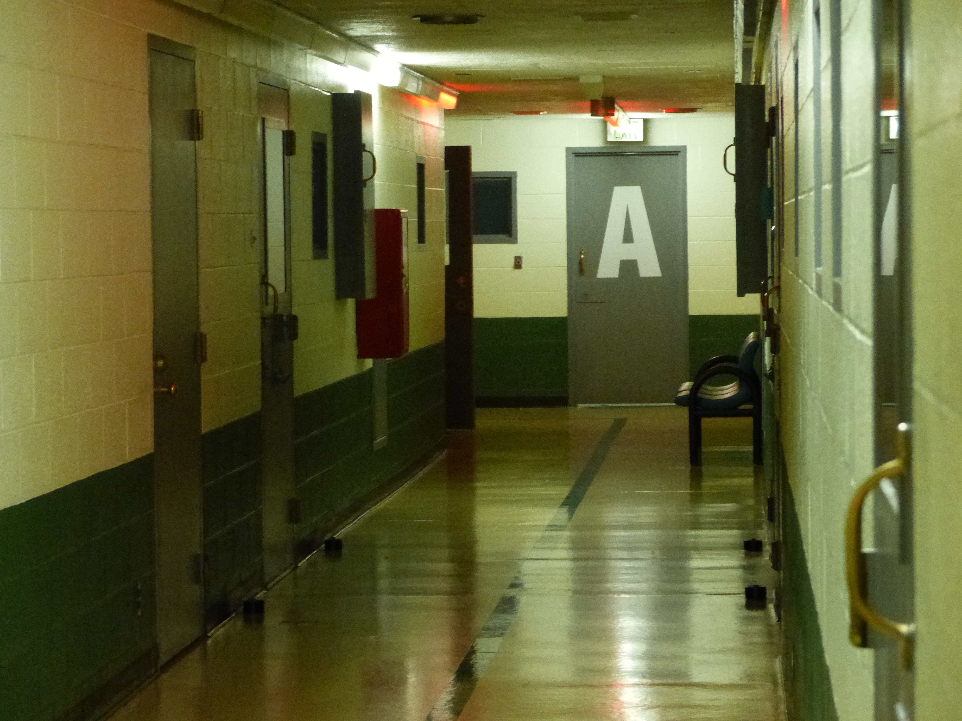
Scenario:
In-Person Services
Scenario:
In-Person Services
Just Detention International

Slide 46
Scenario Exercise
With the help of the PREA coordinator, you arrange to meet in person with a survivor as follow-up after a forensic exam. You’ve visited the facility before and you’re familiar with their visitor policy. When you arrive, a corrections officer takes you to a large visiting room filled with inmates and their visitors, all sitting at tables close to each other. The officer indicates you should sit at one of the tables.
What do you do?
Robert Stolarik/The New York Times

Slide 47
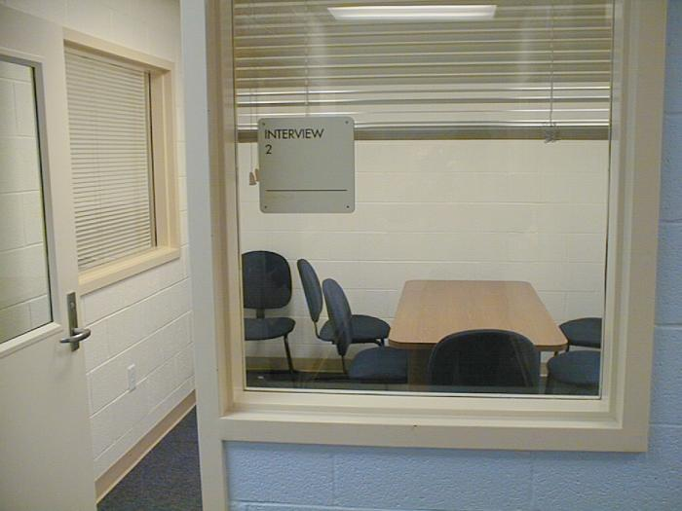
The Expected
Confidential Room
Fairfax County Juvenile Detention Center

Slide 48
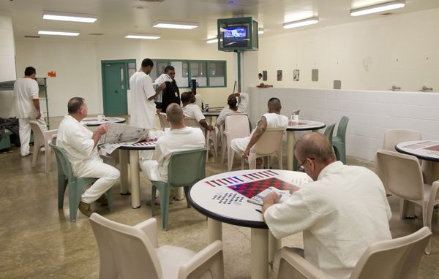
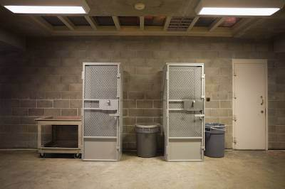
The Unexpected
Non-Confidential Setting
Jay Janner/American-Statesman
Temporary Housing Units
Richard Ross

Slide 49
Challenges
Safety concerns
Challenging corrections staff
Lack of confidentiality
Providing services in a restrictive environment

Slide 50
What’s Next?
Try to work with what you are given
Look for a comfortable alternative
Ask the survivor what they want
Remember why you’re there

Slide 51
Crisis Line
Charlie Riedel/AP

Slide 52
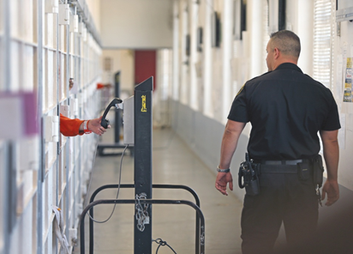
Phone Calls in Detention
Treat calls from detention facilities like any other crisis line call
Normalize trauma responses
Offer and obtain consent to follow up
Mike Koozmin/San Francisco Examiner

Slide 53
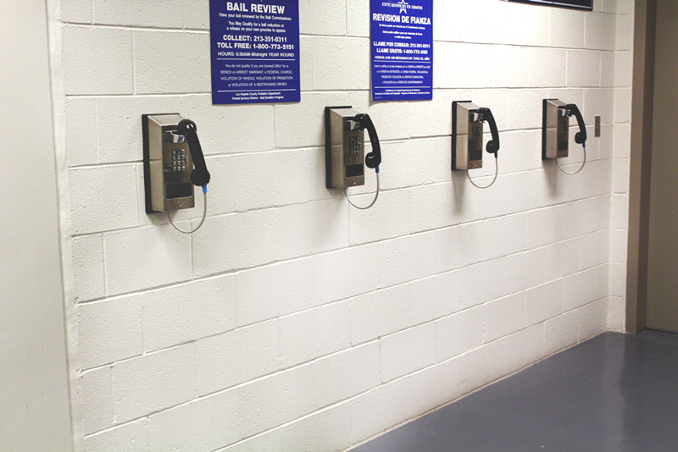
Things to Consider
Calls may be monitored or recorded
Survivor may be in a public space
Call times might be short and costly
People might call with other concerns
Just Detention International

Slide 54
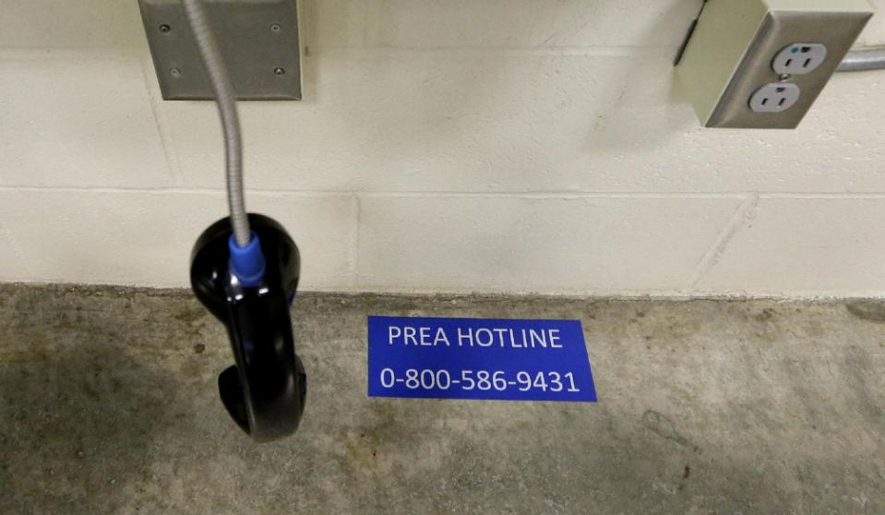
Scenario:
Crisis Line Call
Elaine Thompson/AP Photo

Slide 55
Scenario Exercise
You are working a crisis line shift when you receive a call from a detention facility. You can hear people talking in the background. The caller seems distressed and tells you that his cellmate has been stealing his things. He also tells you that he is innocent and shouldn’t be in prison and asks for your help.
What do you tell this caller?
Robert Stolarik/The New York Times

Slide 56
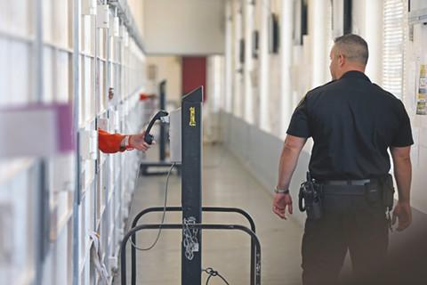
Challenges
Confidentiality
Lack of disclosure
Needs services beyond the scope
Mike Koozmin/San Francisco Examiner

Slide 57
How to Respond
Review rape crisis center services
Offer appropriate resources if available
Remember that the caller may be a survivor
Katie Gandy/The Charleston City Paper

Slide 58
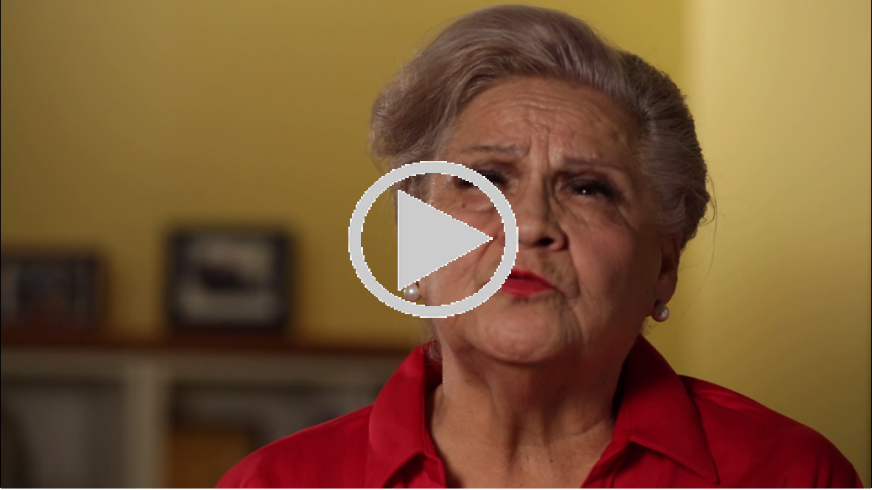

Slide 59
“Thank you for helping me realize I, too, am a person and I didn't deserve the treatment I received. Thank you for helping me realize I have a voice and that there are people willing to listen to me."
— Kerri Cecil, a prisoner rape survivor

Slide 60
Key Takeaways
Remember incarcerated survivors need the skills you already have
Be patient, consistent and persistent
Maintain professional boundaries
Have a plan but be flexible when needed
Just Detention International

Slide 61
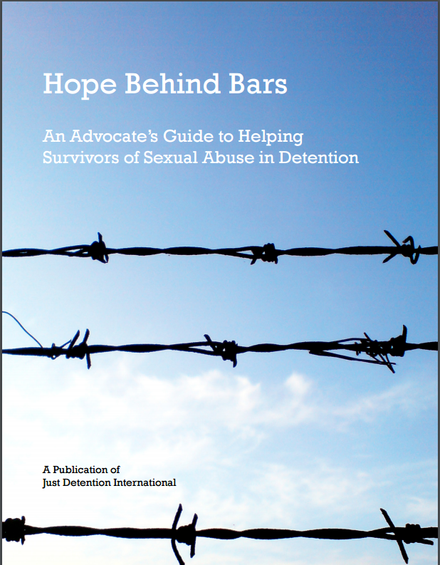
Online Resources
Just Detention International justdetention.org
Hope Behind Bars: An
Advocate’s Guide
Hope for Healing: Information for Survivors
Archived webinars
Other publications

Slide 62
CA Advancing PREA Contact Information
We are here to support you:
prea@calcasa.org
or
advocate@justdetention.org

Slide 63
iStock

Slide 64
Acknowledgments
This project is supported by Grant No. AP14-01-8671, awarded by CalOES. The opinions, findings, conclusions, and recommendations expressed in this web conference are those of the presenters and do not necessarily reflect the views of the Governor’s Office of Emergency Services.

