Slide 1
Tax Check Off: California Sexual Violence Victim Services Fund

Slide 4
Web Conference Presenters
Sandra Henriquez, Executive Director, CALCASA
Shaina Brown, Public Affairs + Communications Associate,
CALCASA

Slide 5
It’s On Us
President Obama at the 2015 Grammy’s

Slide 6
What do you feel when you pay your taxes?

Slide 7
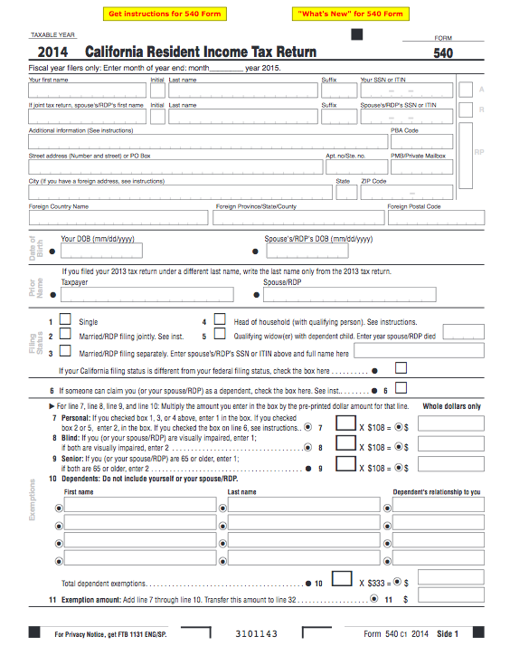
Paying taxes is now an opportunity to support survivors of sexual violence

Slide 8
Background
Stable funding for CA RCCs is a top programmatic and legislative priority for CALCASA
CALCASA sponsored SB 782 (DeSaulnier) - Created new funding stream for sexual assault intervention and prevention services and education
Notes:
SB 782 had broad base support from Republicans and Democrats
You assisted by sending letters of support, meeting with legislators in district, and through advocacy campaigns via Salsa Labs
SB 782 was signed by Gov. Brown in September 2015

Slide 9
Sexual Assault Violence Victims Services Fund
Managed by CalOES
Provides grants to CA RCCs for the following activities:
Emergency back-up
Emergency fund resources
Community education
Training
Notes:
Emergency back-up (hotline or in-person advocacy/accompaniment);
Emergency fund resources (transportation, hotel and food vouchers);
Community education;
Training (self-defense workshops, etc.)

Slide 10
How the tax check-off works
A CA resident must file and state and federal tax return each year
Depending on one’s earnings, tax rate, deductions, etc., an individual will either owe taxes or will be paid a tax return.
Regardless, any individual can allocate an amount over $1.00 to the California Sexual Violence Victim Services Fund
Notes:
1. State tax return is Form 540

Slide 11
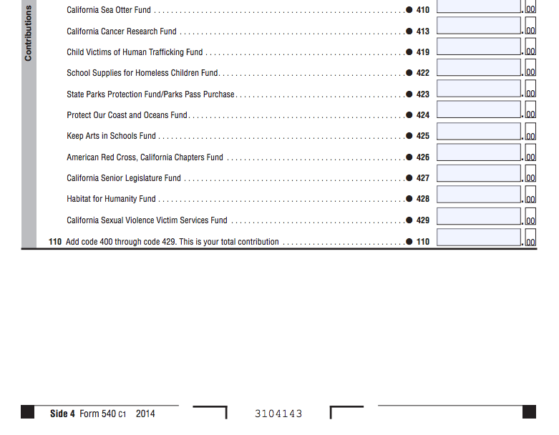
CA State Tax Return – Form 540
Form 540 Instructions
Form 540
Notes:
We will share Form 540 – CA State Tax Return and Directions
Form 540 - https://www.ftb.ca.gov/forms/2014/14_540.pdf
Instructions – page 14 https://www.ftb.ca.gov/forms/2014/14_540ins.pdf

Slide 12
CA State Tax Return
Tax payers can designate portion of CA State Tax Return to be transferred via “Voluntary Contributions” located on:
Form 540
Side 4
Line 26
Code 429 - California Sexual Violence Victims Services Fund

Slide 13
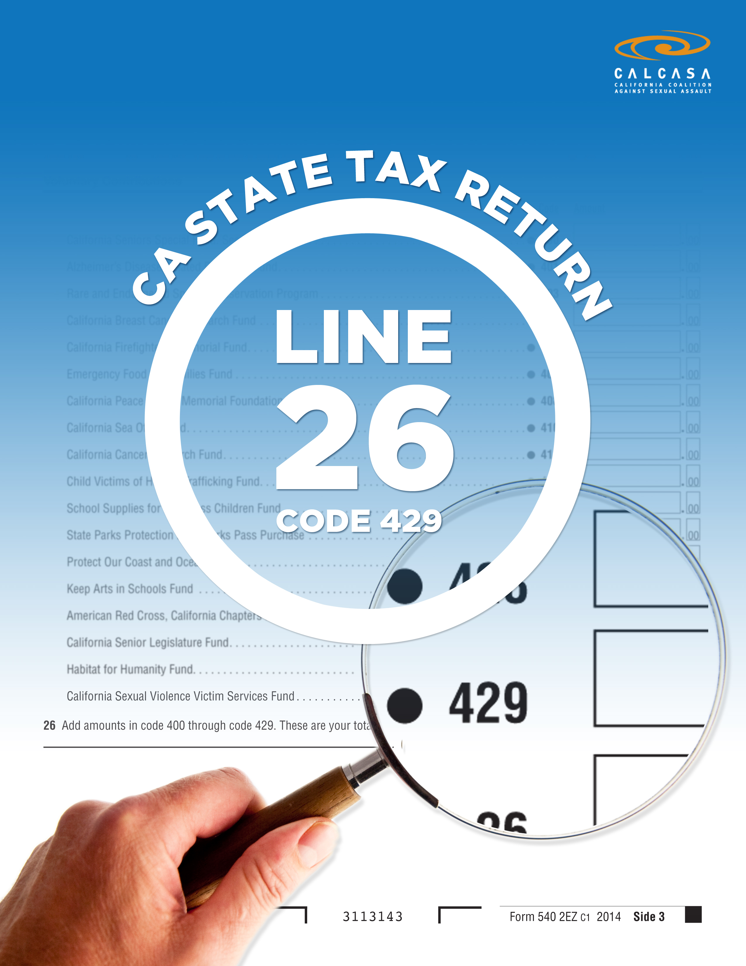
Flyer

Slide 14
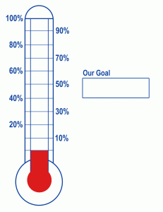
Time to Mobilize!
In order to remain on the CA State Tax Return, we need your help to raise awareness!
$250,000
Notes:
- CALCASA gets NONE of this money – this is for you! Help US raise awareness and increase allocations.
- We will share Form 540 – CA State Tax Return and Directions
- Put on all marketing materials, share on social media, mention in all community presentations
Form 540 - https://www.ftb.ca.gov/forms/2014/14_540.pdf
Instructions – page 14 https://www.ftb.ca.gov/forms/2014/14_540ins.pdf

Slide 15
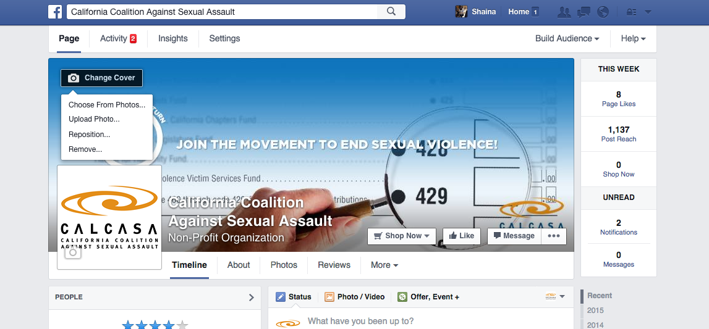
Time to Mobilize!
Social Media
Upload our banner to your Facebook page
1. Click Camera
2. Select “Upload Photo”
3. Choose saved banner file we have provided and select “Open”
4. Reposition as necessary
Notes:
Banner has been distributed and will be available after the presentation

Slide 16
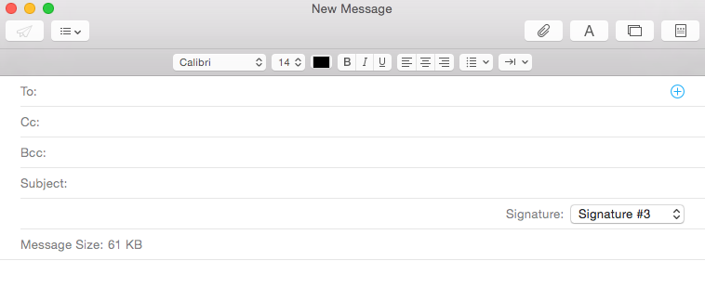
Time to Mobilize!
Share information with funders, community members, partners, and friends!
Use our e-mail template to provide an overview, instructions, and pictures to help them designate a portion of their tax return to Line 26, Code 429!

Slide 17
Time to Mobilize!
Distribute a press release!
Use our press release template to garner attention from local media.
Notes:
We will provide an e-mail template, talking points, and photos and reference forms to make it easy to share this information.
Use prepared talking points to conduct interviews.

Slide 18
Time to Mobilize
Use our image to create e-mail signature
In “settings” of e-mail program, you can add a logo file
Instructions will vary by e-mail program

Slide 19
Question
What ideas do you have to promote the tax check-off?
Notes:
Also, what additional outside institutional data have you used to develop program?

Slide 20
Tools for your use
Flyer
Facebook banner
E-mail template
Press release template
E-mail signature
Talking points

Slide 21
Questions?

Slide 22
For more information contact
Shaina Brown
Shaina.brown@calcasa.org
916-471-6174

