Slide 1

Beyond Trauma, Towards Resiliency: Theory & Practice

Slide 2

Presenters
Patti Giggans, MA, Executive Director, Peace Over Violence
Verna Griffin-Tabor, LCSW, Chief Executive Officer, Center for Community Solutions
Brenda Ingram, EdD, LCSW, Director of Clinical Services, Peace Over Violence
Candace Powell, MA, Counseling and Residential Services Dir., Center for
Community Solutions
Danielle Lingle, Associate Exec. Director of Programs, Center for Community Solutions

Slide 3
Learning Objectives
Participants will:
  Learn how two agencies collaborated to embed trauma-informed and resiliency approaches into daily practice for both clients and staffs.
  Gain knowledge of the neurobiology of trauma and its impact for neuro-sequential programming.
  Learn how to implement an array of practices that yield outcomes of resilience for survivors.
  Take away skills to build practices that create well-being and health for themselves and their clients.

Slide 4
Cross-Agency Collaboration

Slide 5

Mission, Vision & Values
Founded in 1969, Center for Community Solutions (CCS) helps more than 11,000 adults and children each year heal and prevent relationship and sexual violence.
Mission
To end relationship and sexual violence by being a catalyst for caring communities and social justice.
Vision
For all people to live full, free, expressive and empowered lives in a safe, vibrant, healthy and peaceful community.
Values
Social Justice | Integrity | Excellence | Passion
Catalyst for Caring Communities |  | Cultural Competence

Slide 6

Mission, Vision & Values
One of the first agencies of its kind in the country, Peace Over Violence (POV) has been committed to social service, social change and social justice for 41 years. POV’s innovative programs are comprehensive and include Emergency, Intervention, Prevention, Education and Advocacy services.
Mission
Building healthy relationships, families and communities free from sexual, domestic and interpersonal violence.
Vision
Our vision is a world without violence. Where no child is abused, no wife battered, no friend raped. A world without terror, without threats, without wounds from intentional actions. Where the strong provide for the vulnerable, where the vulnerable become empowered, where every kind of family is safe and secure, and girls and boys and women and men have a fair and equal chance at the pursuit of happiness in a tolerant and talented society.

Slide 7
“…assimilating and liquidating traumatic experience produces a feeling of TRIUMPH.”
- Judith Herman, Trauma and Recovery

Slide 8
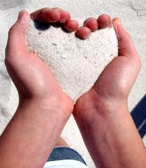
The Democratization of Healing
“What we want to achieve is nothing less than the democratization of healing.”
- Patti Occhiuzzo Giggans

Slide 9
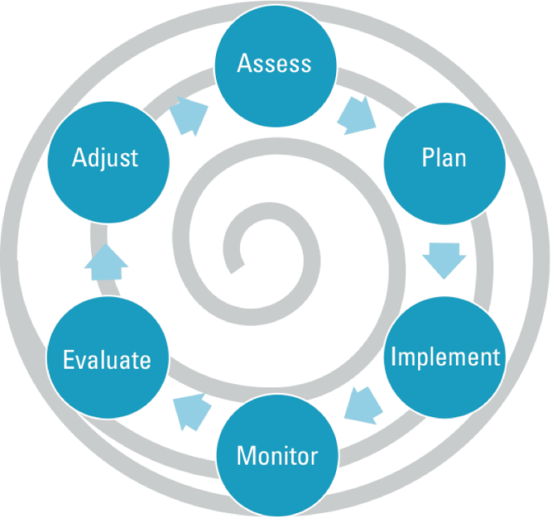
The Process
Laid the foundation for inter-agency collaboration
Created a shared vision for the direction of the project
Formed research teams
Reviewed 51 mind/body/spirit/social healing modalities
Settled on 24 modalities between both agencies
Trained like crazy!
Documented, observed, evaluated feedback-looped

Slide 10

Building the Framework
Developed shared values and a vision for the project.
Built a framework for collaboration and communication between POV and CCS.
Defined the desired outcome that CCS and POV hoped to achieve through this project.
Identified and assigned work to be done
to prepare each agency to achieve the
envisioned transformation, including
researching best-practice trauma
treatment methods and approaches.

Slide 11
Building Capacity
CCS & POV Training
Resiliency Skills
Community Resiliency Model (CRM)
Trauma Resiliency Model (TRM) | Neurobiology of Trauma
Trauma Releasing Exercises (TRE) | Bessel van der Kolk
Seeking Safety | Daniel Siegel
Beyond Trauma | Elaine Miller-Karas
Dialectical Behavioral Therapy (DBT) | Stephen Porges
Self-Defense | Peter Levine

Slide 12
Building Capacity
CCS & POV Training
Mindfulness, Meditation, & Imagery
Jack Kornfield | Neuro-sequential Programming
Daniel Siegel | Judith Herman
Marsha Linehan | Gabriella Grant
Jon Kabat-Zinn | Daniel Siegel
Thich Nhat Hanh
David Emerson (TI Yoga) | Parenting
Belleruth Naparstek | Heather Forbes
Mindfulness Awareness Research Center (MARC) at UCLA | Echo Parenting

Slide 13
Building Capacity
CCS & POV Training
Mind/Body/Spirit Awareness
David Emerson (yoga)
Lisa O’Shea (Qi Gong) | Expressive Arts
Andrew Weil (breath-work) | A Window Between Worlds
Elaine Miller-Karas (tracking) | International Play Therapy
Peter Levine (interoception) | Association
David Emerson (TI Yoga) | Theater of the Oppressed
Babbette Rothschild
Sharon Porter

Slide 14
TRIUMPH MODEL

Slide 15
The Neurobiology of Trauma

Slide 16
Trauma
Understanding trauma is not just about acquiring knowledge. Its about changing the way you view the world.
It’s about changing the helping paradigm from “What is wrong with you?” to “What happened to you?”
  - Sandra Bloom, 2007

Slide 17
Trauma
What is trauma?
  Literally a wound—psychological versus physical
  Psychological trauma occurs when a sudden, unexpected, overwhelming intense emotional blow or a series of blows assaults the person from outside.
Traumatic events are external, but they quickly become incorporated into the mind (Terr,1990) and the body
(van der Kolk,1997).
According to Judith Herman’s book, Trauma and Recovery (1992), psychological trauma is characterized by feelings of:
  Intense fear
  Helplessness
  Loss of control
  Threat of annihilation

Slide 18
Trauma
Trauma is defined using eight general dimensions and six specific distinctions.
Dimensions (Wilson & Sigman, 2000)
Threat to life of limb
Severe physical harm or injury, including sexual assault
Receipt of intentional injury or harm
Exposure to the grotesque
Violent sudden loss of a loved one
Witnessing or learning of violence to a loved one
Learning of exposure to a noxious agent
Causing death or severe harm to another
Distinctions
Physical trauma
Psychological trauma
Social trauma
Historical trauma
Ongoing trauma
Vicarious, or secondary, trauma

Slide 19
Prevalence of Trauma
It is estimated that at least half of all adults in the U.S. have experienced one incident that was caused by a major traumatizing event (Briere & Scott, 2006).
For children the prevalence is believed to be even higher than that experienced in adulthood:
Some studies have found up to 60-70% of urban youth have experienced a traumatizing event in their lives. Exposure to traumatizing events is occurring at an epidemic rate (Geffen, Griffin & Lewis, 2008).
ACEs Study found that childhood trauma is very common ~ 70%. The average number of adverse childhood experiences is about 4.

Slide 20
Sexual Trauma
Sexual trauma refers to one or multiple sexual violations that invoke significant distress.
The term sexual trauma is recommended in response to observations that some survivors do not label their experiences as rape or assault due to familiarity with the perpetrator or the absence of force.
Clinical observations have also suggested that sexual trauma may be a less stigmatizing term for some survivors and may promote healing by acknowledging the impact of the violent act on the individual’s well-being.
The term sexual trauma compounds the acts of violence with survivors’ responses.

Slide 21
Sexual Trauma
Survivors of childhood and adulthood sexual trauma are at high risk of posttraumatic stress disorder (PTSD).
In a recent study, women who reported childhood sexual abuse were five times more likely to be diagnosed with PTSD compared to non-victims (Coid et al., 2003).
Another study shoed that the lifetime rate of a PTSD diagnosis was over three times greater among women who were raped in childhood compared to non-victimized women (Saunders et al., 1999).
Survivors are also more likely to suffer from depression, suicide, and other mental health problems.

Slide 22
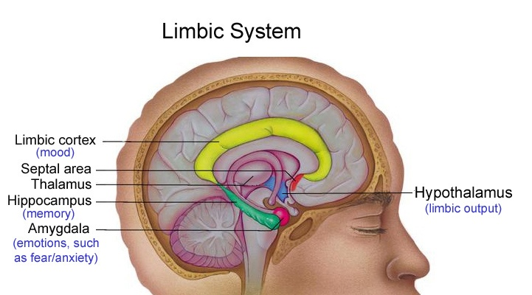
Trauma-Response—Neuroscience

Slide 23
Axis HPA (Hypothalamus-Pituitary-Adrenal)
(Cycle of Panic)
Amygdala
(scans the senses for signs of threat, danger, change, or stress)
Hypothalamus
CRF (corticotrophin releasing factor)
Pituitary Gland
ACTH (adrenocorticotropic hormone)
Adrenal Glands
Cortisol (adrenaline, stress hormones)

Slide 24
The “Stress Hormone”
Produced by your adrenal glands, this “stress hormone” helps regulate blood pressure and the immune system during a sudden crisis (trauma).
Chronic trauma or deregulation can keep this survival mechanism churning in high gear, having a negative effect.
Chronically high cortisol levels can cause sleep problems, a depressed immune response, blood sugar abnormalities, abdominal weight gain, and over long periods of time, can cause damage and cell death in the brain.

Slide 25
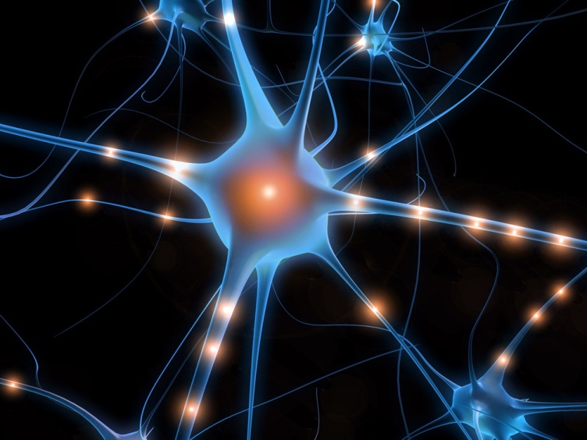
Cortisol
Some of this damage is immediate but most of it happens in the 48 hours following the traumatic event, when certain chemicals are released.
Cortisol is a hormone related to high stress (i.e. tummy chemical).

Slide 26
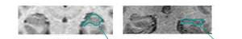
Hippocampal Volume Reduction in PTSD
Normal
PTSD
MRI scan of the hippocampus in a normal control and patient with PTSD secondary to childhood abuse. The hippocampus, outlined in blue, is visibly smaller in PTSD. Overall there was a 12% reduction in volume in PTSD.

Slide 27
What is Traumatic Stress?
The reactions someone may develop after a traumatic event due to experiencing extreme stress.
Reactions vary considerably.
Some people experience anxiety, fear, shock, and upset or even numbness.
Some report disturbances in sleep with nightmares.
These reactions can interfere with activities of daily living.

Slide 28
Traumatic Stress
Since the beginning of time, mammals have responded to life-threatening events in similar ways.
We are born with a number of innate emotions that are part of our mammalian heritage and that produce patterned and predictable responses in all of our organs, including our brain.
Overwhelming emotions can do damage to our bodies as well as our psyches.

Slide 29
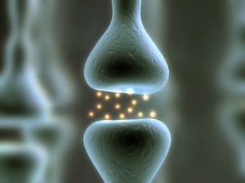
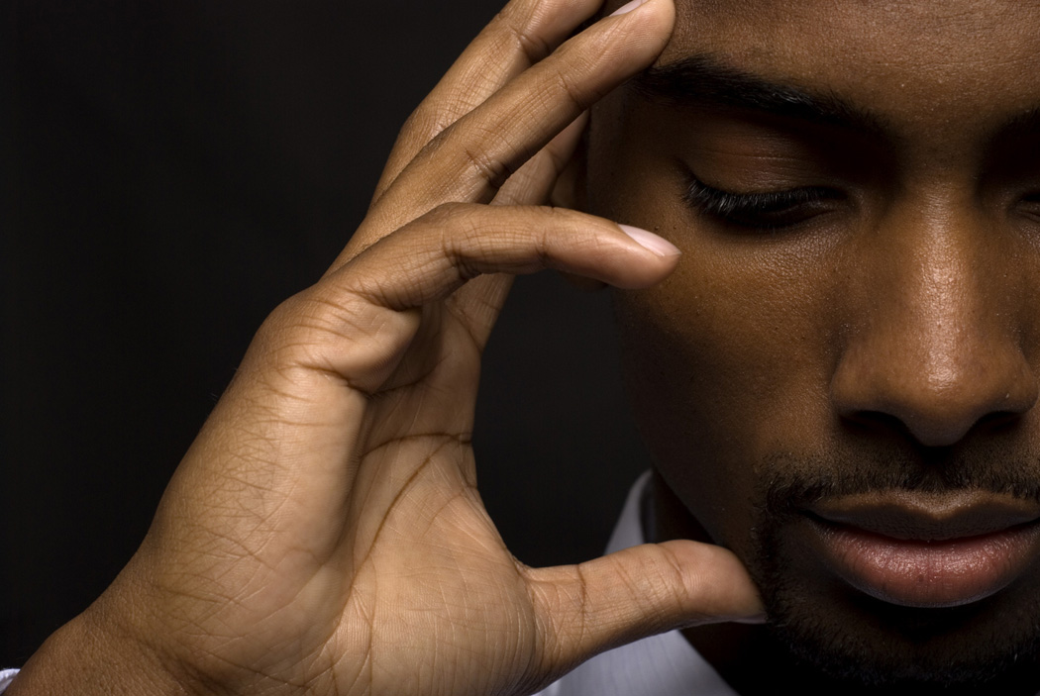
How does this effect our functioning….

Slide 30
Trauma and the Body
When discussing trauma, one must use a mind/body paradigm.
Adults report many somatic symptoms of stress.
Children who have suffered chronic trauma, abuse and neglect often suffer from a multitude of physical disorders not directly related to whatever injuries they have suffered.
We know that chronic trauma/stress has a direct relationship to heart disease, cancer, chronic lung disease, skeletal fractures, liver disease, diabetes, and chronic pain. For sexual trauma, ailments include lower back pain, chronic yeast infections, gynecological complaints, vaginal pain, and sexual dysfunctions.

Slide 31
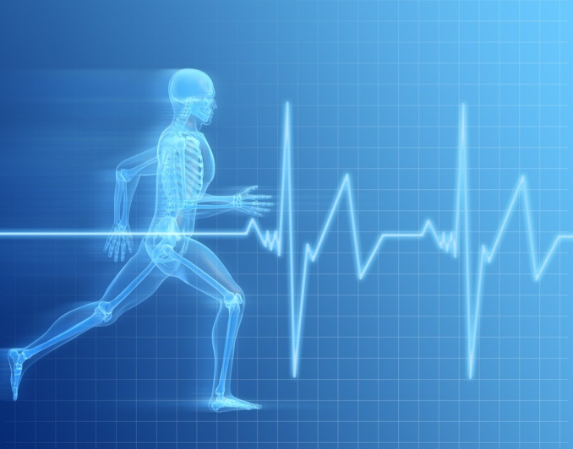
Stored in the body…
While your brain sends the signals to your body—
its important to know that you have a PHYSICAL
body reaction to trauma.
This is not “all in your head.”
Your body has a direct reaction and can even
store memory of the trauma in your muscles.

Slide 32
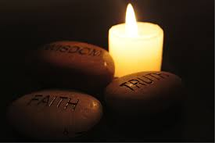
Trauma and Spirituality
Spirituality is a personal experience with
many definitions.
Spirituality might be defined as “an inner belief system providing an individual with meaning and purpose in life, a sense of the sacredness of life, and a vision for the betterment of the world.”
Other definitions emphasize “a connection to that which transcends the self.” The connection might be to God, a higher power, a universal energy, the sacred, or nature.
Researchers in the field of spirituality have suggested three useful dimensions for thinking about one’s spirituality:
Spiritual beliefs
Spiritual practices
Spiritual experiences

Slide 33

Trauma and Spirituality
Evidence suggests that trauma can produce both positive and negative effects on the spiritual experiences and perceptions of individuals.
These effects may change as time passes and a person moves further away from the acute phase of trauma recovery.
On the positive side, some individuals experience increased appreciation of life, greater perceived closeness to God, increased sense of purpose in life, and enhanced spiritual well-being even following devastating events such as disasters and rape.
For others, trauma can be associated with loss of faith, diminished participation in religious or spiritual activities, changes in belief, feelings of being abandoned, or punished by God, and loss of meaning and purpose for living.

Slide 34
Trauma and Memory
The body and brain react to and record trauma in a different way than we have traditionally been led to believe.
When trauma occurs, the prefrontal cortex will frequently shut down, leaving the more primitive portions of the brain to experience and record the event.
The more primitive areas of the brain do a great job of recording experiential and sensory information, but they don’t do very well recording the kinds of information many professionals have been trained to obtain.
Most interview techniques have been developed to interview the more advanced portions of the brain (prefrontal cortex) and obtain specific detail/peripheral information such as the color of a shirt, description of the suspect, time frame, and other important information (Strand, 2013).

Slide 35
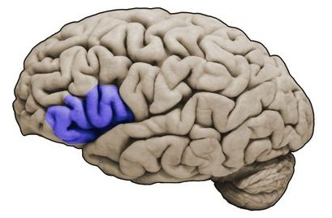
“I just can’t find the words…”
Decreased activity in Broca’s area of the brain:
Broca’s area is related to speech.
When experiencing trauma, access is limited and it may be difficult to speak.
Some believe that this is why children struggle to use words to explain their traumatic experiences and use play instead.

Slide 36
The Impact of Trauma
One of the enduring effects of unresolved trauma is dominance of the fear-driven back of the brain stem.
Fear-driven people are anxious, hyper-vigilant, and avoidant.
They do what it takes to flee and avoid whatever makes them unhappy or uncomfortable.
They are rarely far from the very feelings and events they fear, and often participate greatly in producing the very thing they fear.

Slide 37
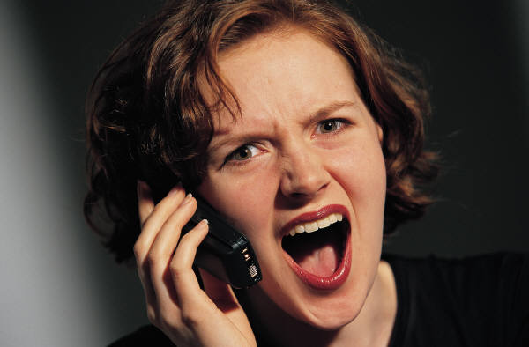
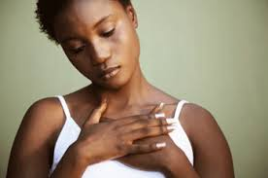
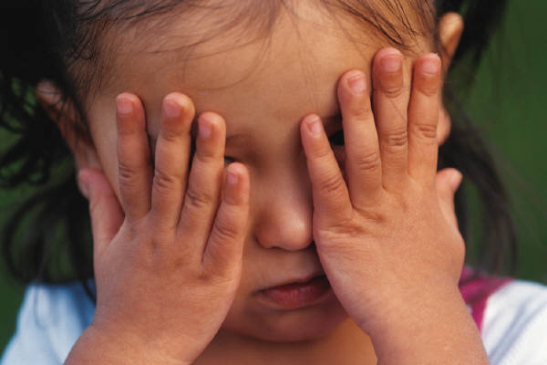

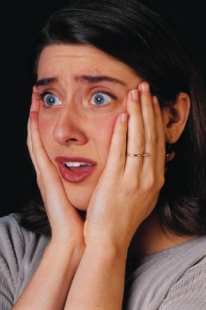
A “Normal” Reaction to Trauma…
It is important to know and understand there is NO “normal” way to react to trauma.
Here are some of the many possible reactions to trauma:
Crying
Laughing
Silence
Anger
Illness
Fatigue
Sleep
Depression

Slide 38
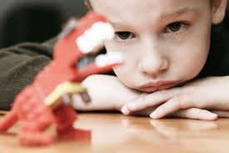
Acting Out…..
Children and adults can “act out” or can “act in.”
Loss of eye contact
Detaching/becoming numb
Becoming angry for no reason
Tantrums
Bedwetting or regression
Wanting to “hit” something
Skipping work or school
Drinking or using drugs (avoidance)
Not wanting to be touched
Depression

Slide 39
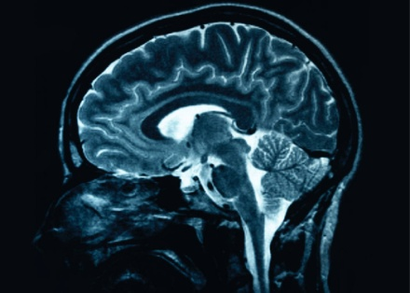
PTSD Symptoms
Re-experiencing
Reliving event through nightmares
Reliving event through flashbacks
Memory “triggered” by any of the five senses
Anxiety, panic attacks
Trouble sleeping and concentrating

Slide 40

What is Neuroplasticity?
Changes in neural pathways and synapses which are due to changes in behavior, the environment, and neural processes, as well as changes resulting from bodily injury.
Neuroplasticity has replaced the formerly held position that the brain is a physiologically static organ, and explores how—and in which ways—the brain changes throughout life.

Slide 41

Negative and
VERY POSITIVE!
The more often neural pathways fire, the stronger the connections will become.
This is the basis of all learning and memory formation.
“Neurons that fire together, wire together.”
The big implication here is that if our brain changes itself based on our experiences, then by changing our experiences, we can actively re-shape our brains.

Slide 42

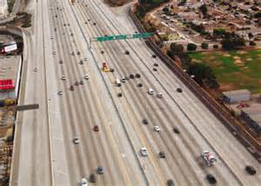
Creating new pathways….
Just like your brain created new pathways every time it experienced trauma or was triggered, your brain can, through experience and practice, create new and more useful pathways.

Slide 43


Why is this so important to know?
If we can pay attention to our clients and meet them where they are functioning, we can better help them to feel understood, heard, and ultimately heal their trauma without being re-traumatized by misunderstanding.
Because if the brain retains
the ability to be changed as
a result of trauma, it will
also have the ability to heal…

Slide 44
Trauma Informed Care (TIC)
An organizational structure and treatment framework that involves understanding, recognizing, and responding to the effects of all types of trauma on the well-being and behavior of survivors.
TIC emphasizes physical, psychological, social, and moral safety for both consumers and providers.
TIC helps survivors rebuild a sense of control and empowerment.

Slide 45
Essentials of Trauma Informed Care
Connect—focus on relationships
Protect—promote safety and trustworthiness
Respect—engage in choice and collaboration
Redirect (teach and reinforce)—encourage skill-building and competence
(Hummer, Crosland, & Dollard, 2009)

Slide 46
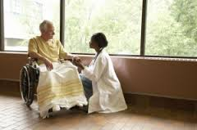
Trauma Informed Care Intervention
“There is no more effective neurobiological intervention than a safe relationship.”
- Bruce Perry, MD
The relationship works to bring the brain back into regulation.
Safe, predictable, and consistent relationships.

Slide 47
Trauma Informed Methods

Slide 48
TRIUMPH
Trauma
Resiliency
Integration
Using
Multiple
Pathways to
Healing

Slide 49
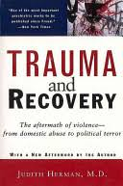
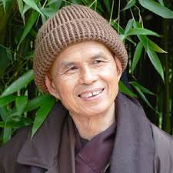


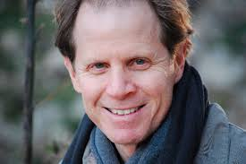
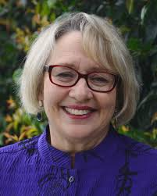
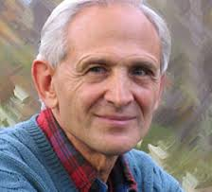
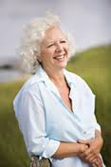
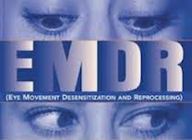
Our Inspirations
Empowerment Model
Three-Stage Model of
Trauma & Recovery
Mindfulness Therapies and Practice
Body-Mind-Spirit Approaches
Bilateral Stimulation Techniques

Slide 50
TRIUMPH Service Principles
Strengths-based assessment is conducted with an understanding of trauma.
Foundation of safety.
Stabilization of nervous system through self-regulation and resiliency.
Work with clients (as advocates, therapists, attorneys, hotline counselors, etc.) from this foundation of strength, safety, and stability.
Notes:
How can we recognize where our clients are and work with them in different ways depending upon how activated they are. If they’re hyper-activated, we use calming and centering techniques.

Slide 51
CCS Core Competencies
Therapeutic Relationship | Trauma-Informed Services
Empowerment | Neurobiology of Trauma
Community Resiliency Model Skills | Risk Assessment
Self-Regulation Skills | Motivational Interviewing
Mindfulness | Self-Defense
 | HIPAA
Notes:
Here’s what TRIUMPH

Slide 52
Core Competencies
Why did we choose to focus on these as core competencies?
How can these skills be applied by people in different roles within our organizations?
receptionist advocate counselor
attorney shelter staff educator
hotline counselor emergency responder
Notes:
Here’s what TRIUMPH

Slide 53
Community Resiliency Model Skill-Building

Slide 54
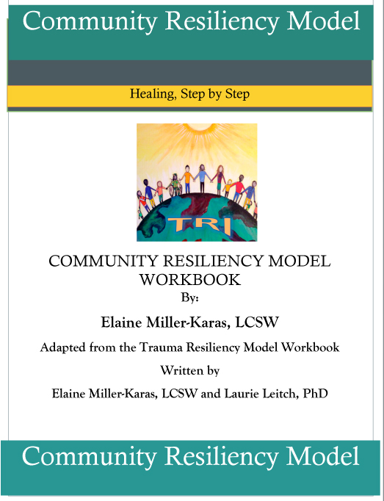
Community Resiliency Model (CRM)

Slide 55


Community Resiliency Model
Our response to trauma and stress impacts our nervous system.
Stress and trauma symptoms are natural
biological reactions, not mental weakness.
Observation of sensations and knowledge
of the nervous system improve self-regulation.
These skills help us come to center & balance.
By building our own resiliency, we are better able to model and teach our clients resiliency skills.

Slide 56
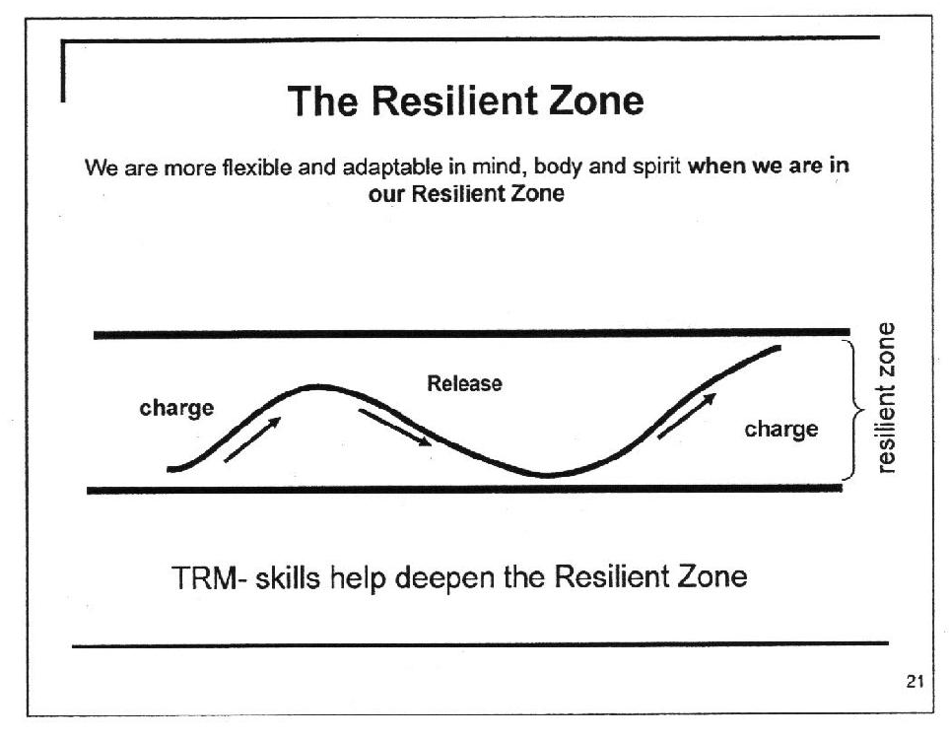

Slide 57
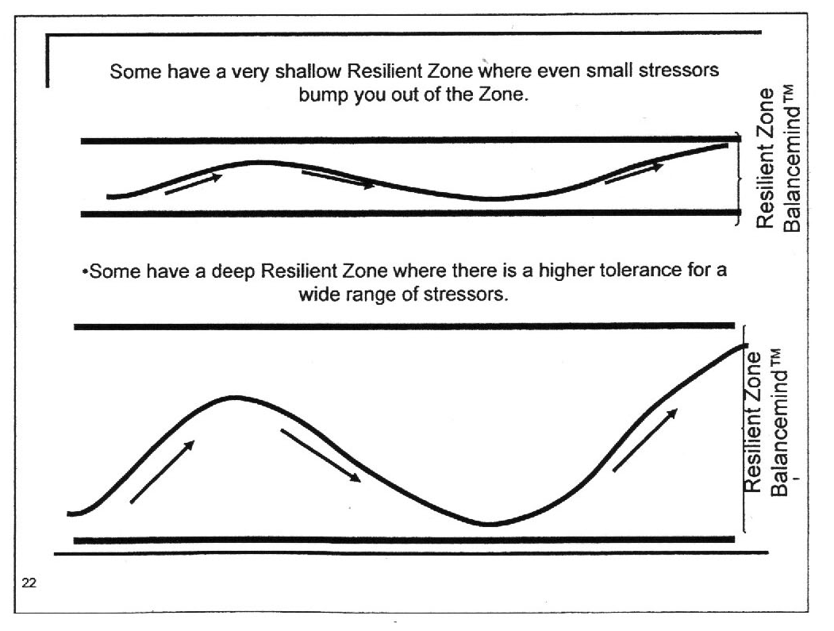

Slide 58

Why deepen our resilient zone?
In the resilient zone, we think more clearly, handle emotions better, and manage sensations inside our bodies.
We can handle stress and stressful events with more tolerance.
We can bounce back to our resilient zone and return to the normal rhythm and flow of our nervous system more easily.
Bounce back to feel our “best self” more often.

Slide 59
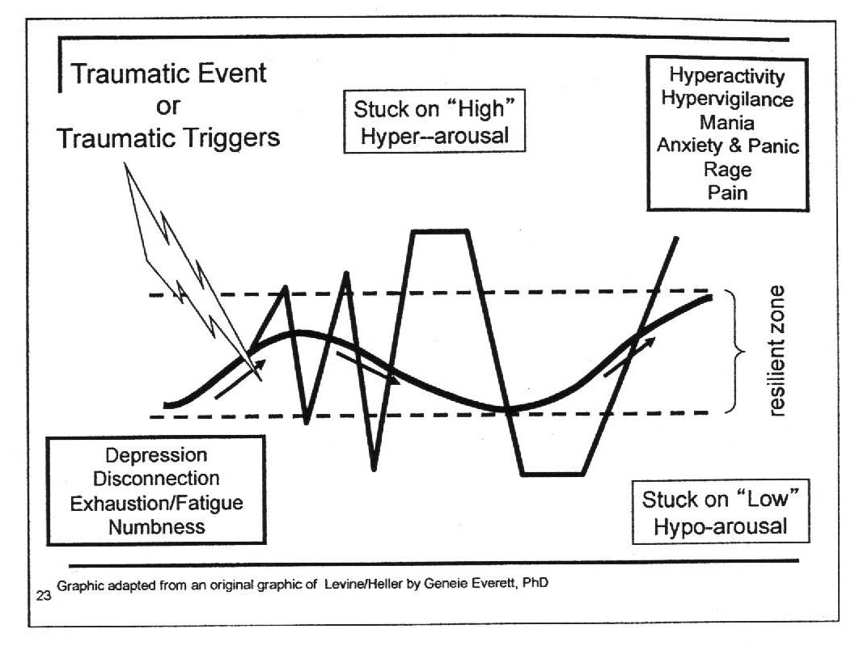
Resilient Zone

Slide 60
Tracking
Body Sensing: Recognizing and monitoring what is happening within our bodies as we experience a situation.
Work with BODY SENSATION: Noticing heart rate, pace of breathing, muscle tension, pain, body temperature, energy flow, and the movement of sensations.

Slide 61
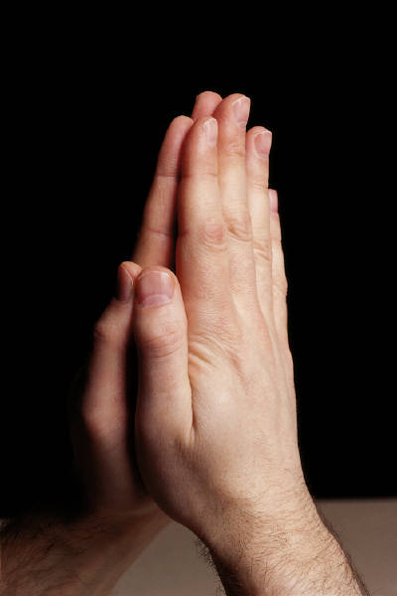
Learning a New Language
Focus is on sensations within the body.
      Not - How are you feeling?
      Not - Description or telling the story.
      Not - Interpretation or blame or meaning.
What are you sensing on the inside?
Where are you sensing it?
Re-directing:
When a person responds with “I feel excited” you can ask “where in your body do you sense that excitement?”.
HANDOUT: The Language of Sensation

Slide 62

Tracking Skills Practice
As you view the following slides, answer the following questions:
What are you sensing or noticing on the inside?
What do you notice about your breathing, heart rate, temperature?
Are any of the sensations changing?
Is the sensation, pleasant, neutral, or unpleasant?

Slide 63


Slide 64
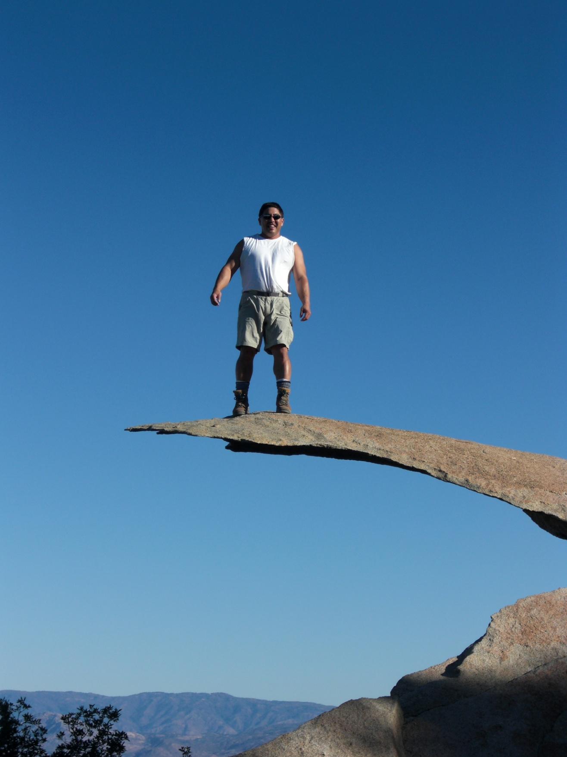

Slide 65

Resourcing
Using positive things in your life to bring balance
back to the nervous system.

Slide 66

Internal Resources
  -- What gives you joy or brings you strength?
    Values: kindness, compassion, humor, faith
    Characteristics: strong legs/ back, good sleeper, straight spine, healthy heart, intelligence

Slide 67

External Resources
A person, place, animal or spiritual
belief that sustains or nurtures you.
  Positive experiences
  People we know, love, admire
  Places that offer peace or safety
  Skills
  Hobbies
  Animals we love
HANDOUT: Resourcing Worksheet

Slide 68
Grounding
The direct contact of the body with the ground or with something providing support to the body (chair, floor, wall).
Helps us stay in the present moment.
When we are stressed or triggered by trauma, we are knocked out of our resilient zone and out of balance.
Grounding brings us back to center or in balance; back to resilient zone.

Slide 69

Grounding & Resourcing Practice

Slide 70
Benefits of Resiliency Practice
Staff who learn to self-regulate operate from position of strength to help clients.
Self-care increases.
Staff model resilience for one another and clients.
Staff teach resiliency skills from a foundation of personal knowledge and experience.

Slide 71
Questions?

Slide 72
For more information
Contact:
Lindsay Riedel
Center for Community Solutions
lriedel@ccssd.org
Brenda Ingram, EdD, LCSW
Director of Clinical Services
Peace Over Violence
Brenda@peaceoverviolence.org

